Slide 1
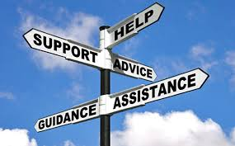
Welcome
Supporting young people through the transition to secondary school
Notes:
Purpose – ease any worries, give information , open up a dialogue with you and your child, questions on 18 June

Slide 2
A welcome from Mrs Horstrup, Deputy Headteacher
https://youtu.be/OnkHwZM_oRI

Slide 3
Who’s Who?
Mrs Jane Mayes – Head of Year 7
Form Tutors
A7 (Aylward): Mr D Coker N7 (Newton): Ms D Negus
B7 (Bronte): Ms N Lusinski P7 (Pankhurst): Ms H White
F7 (Faraday):Mr T Smith R7 (Rutherford): Mrs C Rothery
L7 (Lovelace): Mr M Stewart S7 (Scott): Ms A Bertolin
Mrs Debbie Barton – Pastoral Team Support
Inclusion Manager – Mrs Claire Else and her team of Learning Support Assistants
Mrs Sue Allen – School Counsellor
Mrs Emma Horstrup – Deputy Headteacher (Pastoral)
Notes:
Form tutors can often resolve issues. Please remember all teaching staff teach – and often all day – so if there is an urgent issue, Mrs Debbie Barton is a good avenue.

Slide 4
Communication
Form tutor is often the first contact via:
student planner
direct email
Mrs Barton via phone call to main office or pastoralteam@rmgs.org.uk
Edulink

Slide 5
Year 7 – the start of the journey

Slide 6
The Science Bit
Notes:
Form tutors can often resolve issues. Please remember all teaching staff teach – and often all day – so if there is an urgent issue, Mrs Debbie Barton is a good avenue.

Slide 7
The Teenage Brain
Brain Development

Slide 8
Teenage Brain: advice from our counsellor
Sleep: too much or too little. Don’t be nocturnal.
Coach- what would you do differently?
Listening not always solving. Listen and provide a communicative atmosphere. Stop asking why.
Negotiate.
Having the last word.
Coping with academic pressure…
Notes:
Form tutors can often resolve issues. Please remember all teaching staff teach – and often all day – so if there is an urgent issue, Mrs Debbie Barton is a good avenue.
Support the feeling : stop going rational go emotional. Hormones – “It’s just your hormones” – don’t dismiss

Slide 9
Have you ever heard your child say any of following?:
I am not clever enough
I can’t do Maths/Science/ English
The teacher doesn’t like me
There’s no point trying
I can’t do exams

Slide 10
Have you ever said these things to your child?
You’re so clever you are bound to do well.
Don’t worry maths isn’t that important. I did badly at it.
Some people are naturally better at languages than others.
Don’t listen to any criticism from your teachers. I know you’re great.
You are really bright, you will do well next time.

Slide 11
Have you ever said these things to your child?
Perhaps it’s time to stop…and here’s why
You’re so clever you are bound to do well.
Don’t worry maths isn’t that important. I did badly at it.
Some people are naturally better at languages than others.
Don’t listen to any criticism from your teachers. I know you’re great.
You are really bright, you will do well next time.

Slide 12
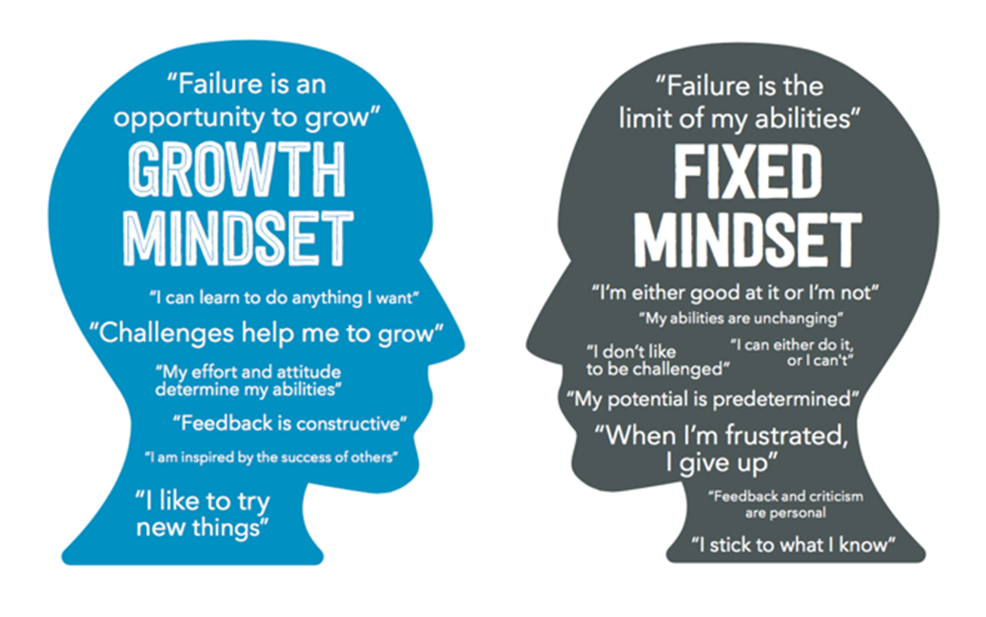
Growth or fixed mindset?
Instead of This (Person-Praise) | Try This (Process-Praise)
Great job! You must be smart at this. | Great job! You must have worked really hard.
See, you are good at English. You got an A on your last test. | You really studied for your English test and your improvement shows it.
You got it! I told you that you were smart. | I like the way you tried all kinds of strategies on that math problem until you finally got it.
You are such a good student! | I love the way you stayed at your desk, you kept your concentration, and you kept on working. That’s great!
Notes:
Don’t normalise low effort

Slide 13
Monitoring Progress: numbers and letters
Decoding reports:
E – Exceeding Expectations (high ability)
A – Achieving Expectations (on target)
T – (Working) Towards Expectations (just a bit below average)
B- (working considerably) Below Expectations
Notes:
Be growth mindset about progress. It isn’t linear. We all know we get things quickly and struggle with other things in the same subject e.g. area in Ma no problem; vectors no thanks! Parents: part of the process of secondary school is learning to fail. It builds independence and resilience . Resist rescuing all the time.

Slide 14
Numbers too
You will also get a numerical value for your progress
It will range from 0.0 to 0.9
0.0 is the bottom end
0.9 is the top end
And because you are in Y7, you’ll be 7.0-7.9

Slide 15
The Four Tiers
Exceeding values will be between 0.8 and 0.9
Achieving values will be between 0.5 and 0.7
Towards values will be between 0.2 and 0.4
Below values will be between 0.0 and 0.1
This means you may get the same letter value e.g. A but you are improving going from 7.5 to 7.6

Slide 16
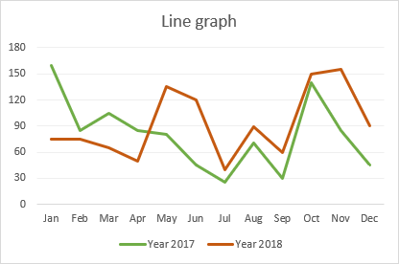
Attitude to Learning or ATL
How much you put into this subject/ effort
Perhaps this is more important than how “good” you are in subjects?
Scale of
4- Excellent
3- Good
2- Satisfactory
1- Poor
Remember progress isn’t always linear…it can be wonky!

Slide 17
A section of a report might look like this…
German 7.5 A
English 7.8 E
Art 7.2 T
P.E. 7.6 A

Slide 18
 | ATL | Homework | Behaviour
History | 4 | 3 | 4
DT | 4 | 3 | 4
Science | 4 | 4 | 4
Maths | 4 | 4 | 4

Slide 19
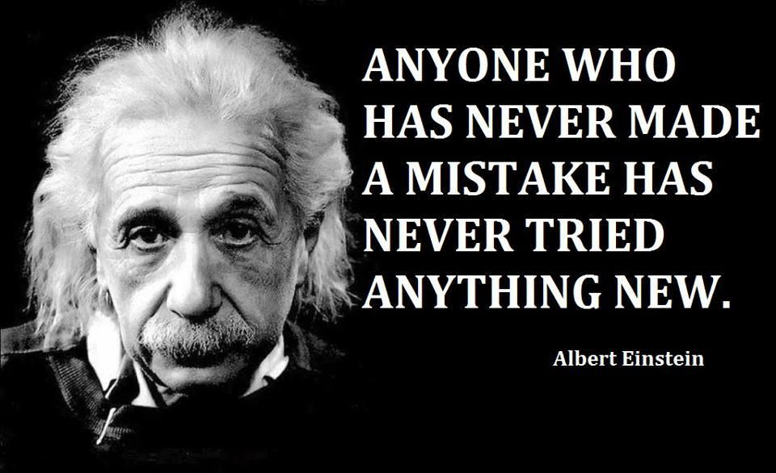

Slide 20
The one thing that your child can do to improve all round performance?
Notes:
Reading enjoyment has been reported as more important for children’s educational success than their family’s socio-economic status

Slide 21
Notes:
Reading and empathy

Slide 22
Organisation
Notes:
Form tutors can often resolve issues. Please remember all teaching staff teach – and often all day – so if there is an urgent issue, Mrs Debbie Barton is a good avenue.

Slide 23
Ensuring the basics are in place
Talk about your own systems you use in your home / working lives.
Student planner has a “remember section” and a ‘due date’
Build in review and reflection:
‘How long did this piece of homework take?’
‘Why was this the most difficult?’
‘Was there anything else on your mind when you were completing this piece of homework?’.
Routine of packing bag and then relaxing.

Slide 24
Prioritising
Important | Not important
Urgent | Not urgent

Slide 25
Top 7 Best Study Apps

Slide 26
Screen time
Is your family’s screen time under control?
Does screen use interfere with what your family wants to do?
Does screen use interfere with sleep?
Are you able to control snacking during screen time?

Slide 27
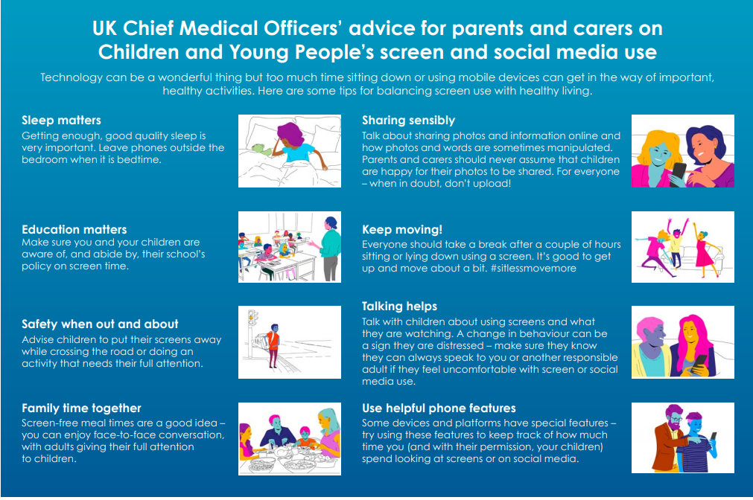

Slide 28
Staying safe online
And on our website too here

Slide 29
Taking back control - time off gadgets

Slide 30
Mental Health and Wellbeing
Notes:
Form tutors can often resolve issues. Conflict will happen: it’s a normal part of growing up.Please remember all teaching staff teach – and often all day – so if there is an urgent issue, Mrs Debbie Barton is a good avenue.

Slide 31
Anna Freud Organisation
We All Have Mental Health

Slide 33
Our website: Care & Guidance , Mental Health & Wellbeing

Slide 34
Our aim is for you to be happy, successful and secure.
School is only one part of your life so make sure you keep up all the hobbies and things that make you, you.
We may have mentioned some of the things that may cause you stress, but actually, most of the time, things will be good.
We are excited at the prospect of meeting you and we hope you feel the same about meeting us.
So, let’s think about September…

Slide 35
Plans for September
At present, our plan is for Wednesday 2 September to be the first day of school for Year 7s starting at 9.30am.
There will only be Year 7 and Year 12 in school that day.
The day will be about settling in, well-being and orientation.
Uniform. House ribbons will be provided. Suppliers are School Time and Rainham Sports https://www.towersports.net/.
Please do not worry if you cannot get everything. We will work it out.

Slide 36
Questions?
Join us on 18 June at 7pm via Zoom for a Q&A session with Mrs Mayes and Mrs Horstrup

