Slide 1
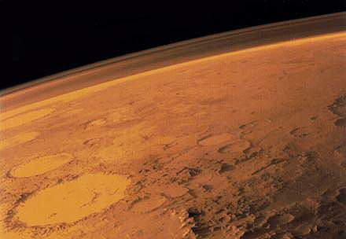
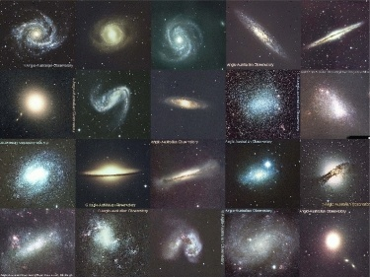
Galaxies
demonstrate an understanding of the appearance of spiral, barred spiral, elliptical and irregular galaxies
draw Hubble’s Tuning Fork diagram
recall that the Milky Way is an Sb type galaxy
use images of galaxies in order to classify them
STARTER:
If you were the first person to set foot on Mars, what would you say?

Slide 2
Oh dear, what a lot of galaxies
There are over 100 billion galaxies in the known Universe.
the Milky Way, a very average galaxy, contains over 200 billion stars held together by gravity
they vary greatly in size, shape and colour.
the appearance will depend on the orientation relative to us, i.e. a spiral galaxy will look very different if viewed sideways.
Charles Messier (1730-1817) catalogued a number of objects in the sky including many galaxies, e.g. the Whirlpool galaxy is M51. From 1888 galaxies, and other celestial objects, were catalogued with the NGC (New general catalogue) system, e.g. NGC891 is a spiral galaxy in the Andromeda system
Find the name of three galaxies listed in the Messier catalogue system
Find the name of three other galaxies listed in the New General Catalogue

Slide 3
Galaxy Clusters
Galaxies are not distributed evenly throughout the Universe. There are regions where there are many more galaxies than in others. Many galaxies are found in clusters.
Find out about our 4 most famous companions.
What is the name given to our little local group of galaxies? What is in our cluster? How big is it?
Our galaxy, The Milky Way, is one of about 30 in The Local Group, a bunch of galaxies relatively close to each other.
The Local Group has a diameter of 10 Mly (3.1 Mpc) (about 10²³ meters) and has a binary (dumbbell) distribution.

Slide 4
Galaxy Clusters
Galaxy --> Group --> Cluster --> Super Cluster --> Universe
Galaxies in the Universe are not evenly distributed. We have seen that the Milky Way is one of a bunch called the Local Group. This group is one of many in a cluster of several thousand galaxies.
Find out the name of our cluster/super cluster
Up to 100 of these clusters make a larger group called a super cluster. Our cluster belongs in one called the Virgo super cluster.
The Universe contains millions of super clusters.

Slide 5
Classifying Galaxies
A method of classification, first introduced by Edwin Hubble in the 1920s, is commonly used to classify galaxies
Galaxies can be classified into 4 main types.
Draw a table to put the following into…..
Find out what the types are called, draw an example image of the galaxy type and describe its features (including the codings used to make the descriptions).
+ Irregular (Irr)

Slide 6
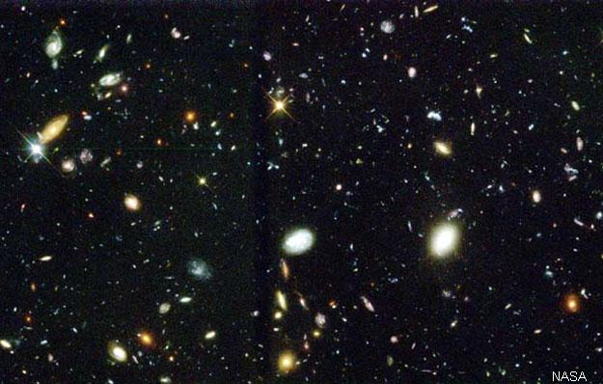

Slide 7
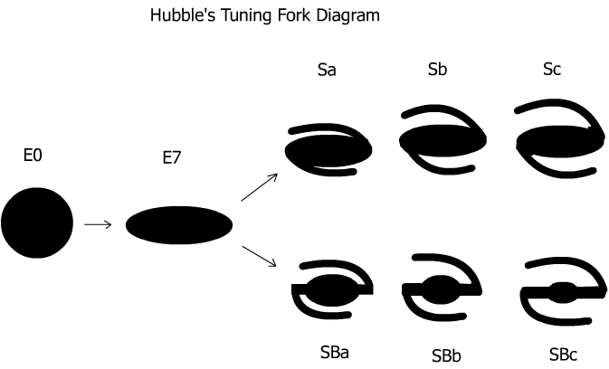
Hubble’s Tuning Fork diagram
Hubble’s classification scheme is often shown on a “tuning fork” diagram.
Find out about this diagram. Make a sketch of it.
Why is is called the “tuning fork diagram”?

Slide 8
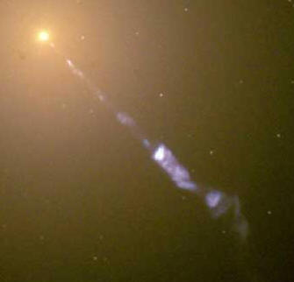
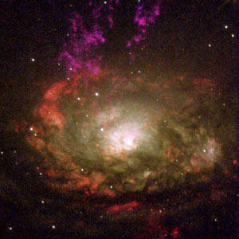
Active galaxies
An active galactic nucleus, AGN, is a region in the centre of some galaxies that emits huge amounts of radiation. Not just visible light but many waves from the rest of the electromagnetic spectrum including radio, infra-red, ultra violet, x-ray and gamma rays.
It is thought that AGN's have super massive black holes at their centre. Matter close to this form an accretion disk, with matter spiralling inwards at incredible speeds. This is what causes radiation to be emitted. As gas spirals into the black hole a huge amount of energy is generated.
Not all the gas is sucked in, some of it escapes as a hot wind that is blown away from the disc at an incredible speed. These are known as galactic jets.

Slide 9
Types of active galaxy
There are four main types of active galaxy
Find out the names of the four types
Radio galaxies
Seyfert galaxies
Quasars
Blazars
Write a paragraph about each type

Slide 10
Radio galaxies, discovered in the 1950s are mainly elliptical and are immense emitters of radio waves originating from pairs of ‘lobes’ that lie on the opposite sides of the galaxy
Seyfert galaxies, discovered in 1943, have very compact and bright nuclei. They emit lots of radiation that shows the presence of hydrogen, helium, nitrogen and oxygen. It is thought that this radiation does not come from the accretion disk but from clouds of gas surrounding the disk.
Quasars (quasi-stellar radio source), discovered in 1963, are extremely bright and distant active galactic nuclei. They consist of a compact halo of matter surrounding a super massive black hole at the centre of a young galaxy. They are one of the brightest objects in the Universe, so bright we don't see the light from other stars in the galaxy they are part of and are amongst the earliest known objects in the Universe. The light from some of them shows a massive red shift, suggesting that they are around 12 billion light years away.
Blazars, discovered in the 1970s, emit amounts of radiation that vary greatly with time. It is thought that it is because their galactic jets are pointing almost directly towards Earth so any variation, e.g. due to rotation, is exaggerated.

