Slide 1
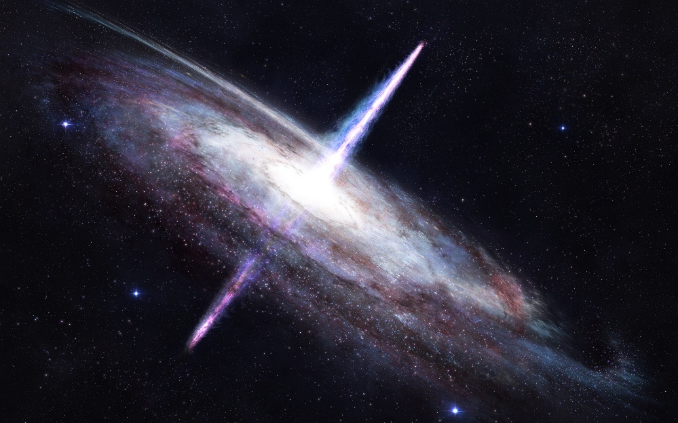
Radio Astronomy
Radio astronomy has been important in:
the discovery of quasars
the discovery of jets from black holes
deducing the structure of the Milky Way
discovering protoplanetary discs.
"quasi-stellar radio sources," or "quasars are distant objects powered by black holes a billion times as massive as our sun. Quasars are discovered by radio telescopes as they appear as very bright objects in the image captured.
Radio telescopes can see the beautiful glowing remains of exploded stars as clouds we call supernova remnants or sometimes nebulae. The first bright radio sources ever found in the sky (besides the Sun and planets) turned out to be black holes in our Galaxy. To radio telescopes, black holes are bright and clear.
Radio telescopes also allow us to see through the dust surrounding a newly born star or in the bulge of our own galaxy.

Slide 2
Solutions
1. visible light (1 mark) and radio waves (1 mark)
2. ‘left’ crossed out (leaving ‘right’) (1)
3. B (1)
4. Jason (1)
5. radio (1)
6. radio (1)
7. A (1)
8. A (1)
9. Any 2 of: quasars, pulsars, radio galaxies, jets from black holes, protoplanetary discs,
structure and rotation of the Milky Way (1 for each; maximum 2 marks)
10. On next page
11. B (1)
12. Any 2 of: this is to achieve the maximum possible resolution (amount of detail) (1).
This is due to the wavelengths of radio waves being large (1); resolution depends
inversely on wavelength (1); large aperture size compensates for large wavelength of
radio waves (1)
13. D (1)
14. 60 (2); allow (1) mark for inverse, i.e. 1/60 or 0.016

Slide 3
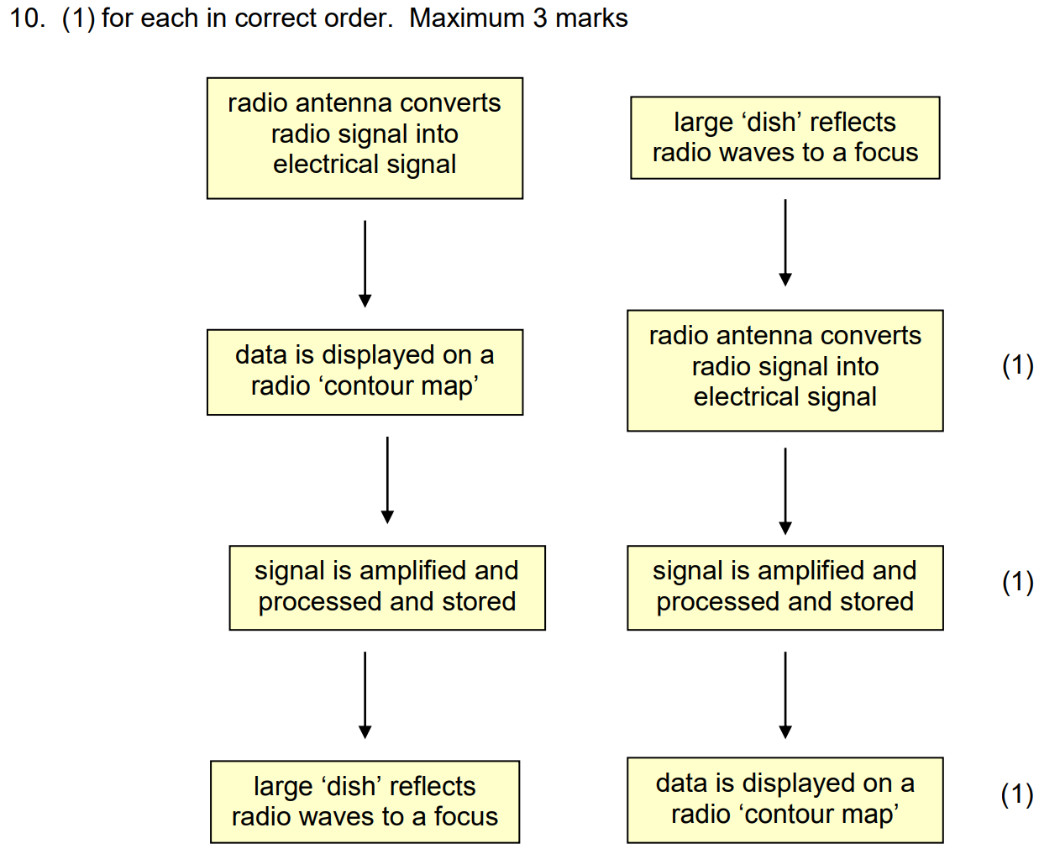

Slide 4
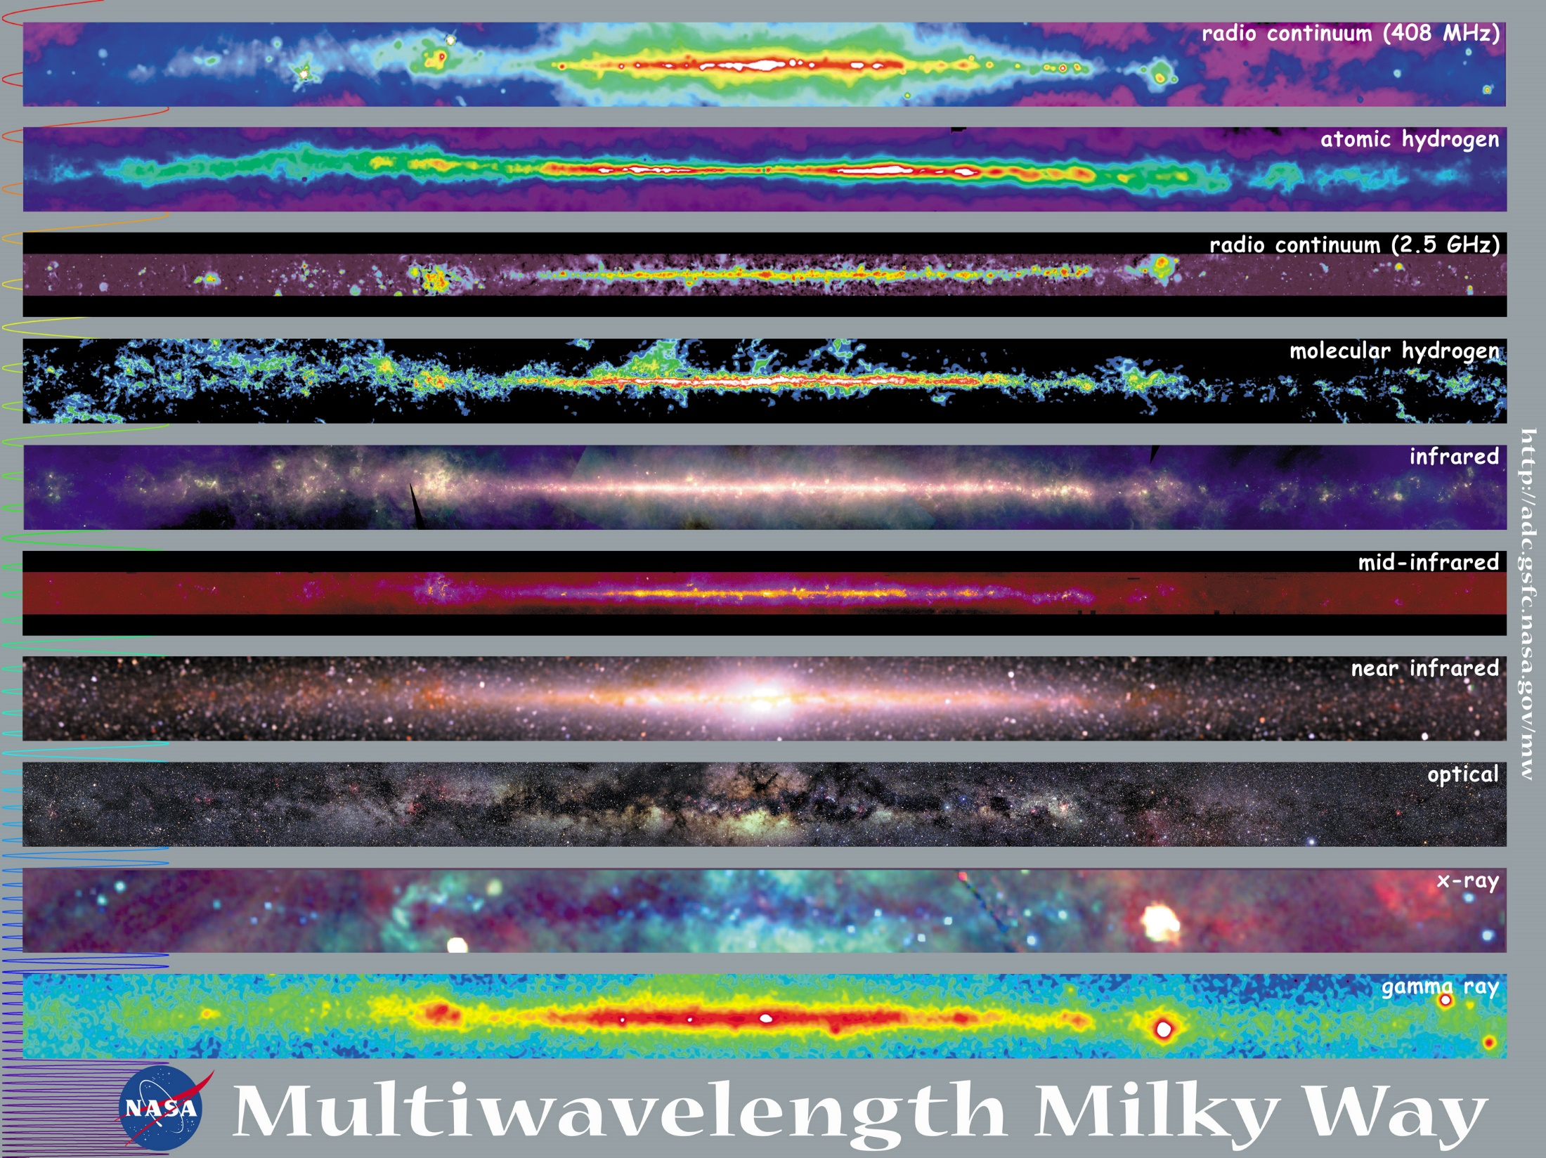

Slide 5
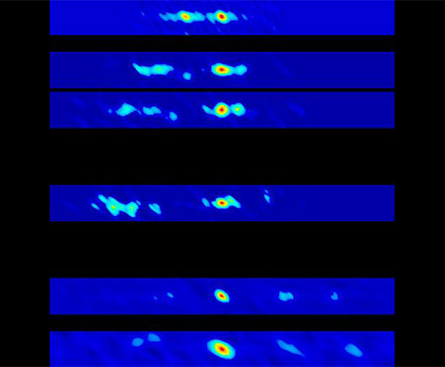
What does a black hole look like?
GRO J1655-40 is a pair of objects that flare in radio waves. One object is a gaseous star and the other is probably a black hole pulling gas from it. When the black hole has been overfed, it burps along its magnetic fields, and we see this in radio waves.

Slide 6
Digital light Sensors and CCD s?
A Digital light sensor has an array of light sensitive cells that will produce an electric current upon detecting a source of light incident on that particular cell. This allows a computer to map out the electrical signals and turn them into a real time display of where the light is hitting the array. This can then be processed by the computer to create an image for the user to view or to be stored as data files for later use.

Slide 9
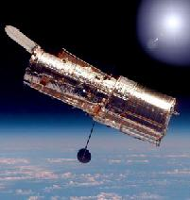
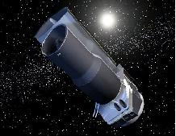
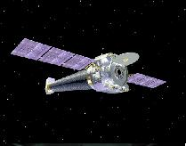
Beat that atmospheric absorption!
Ideally in space above the atmosphere. As well as optical instruments the Hubble space telescope also contains ultra violet and infra-red instruments and it is just one of NASA's "Great observatories". These include the Chandra X ray observatory and the Spitzer infra-red telescope. | Hubble | Chandra | Spitzer
List the pros and cons of using space-based telescopes over land-based ones?
List the detrimental effect of the Earth’s atmosphere on the quality of images obtained from telescopes at sea-level
Many large Earth based telescopes are found on top of mountains, e.g. in Chile. Why?

Slide 10
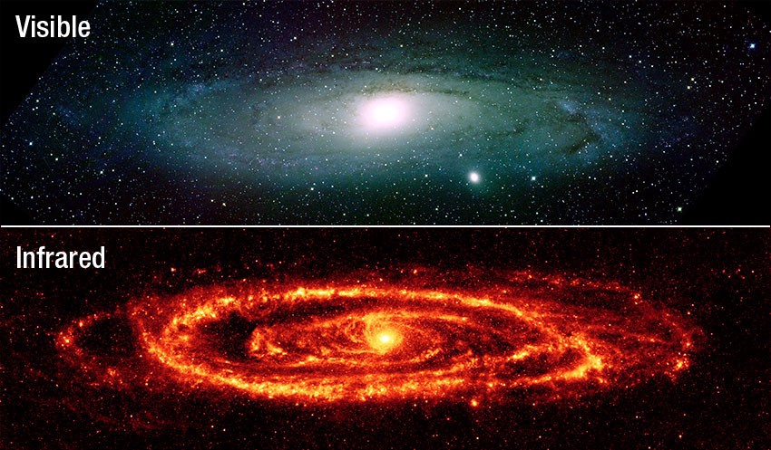
Why are some IR telescopes can be sited on high locations on the Earth’s surface?
Research some information about how is IR astronomy has been important in the discovery of:
protostars
dust and molecular clouds
hotspots on moons.

Slide 11
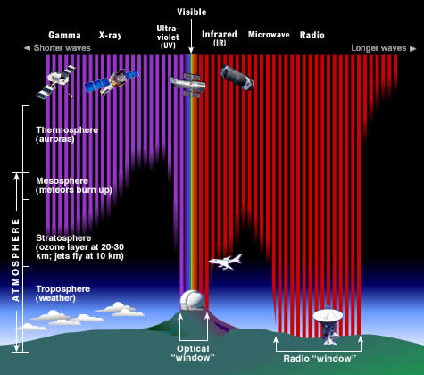
Atmospheric absorption
Certain wavelengths of light — in fact, most of them — never reach the ground. They are absorbed by our atmosphere.
Most visible and radio wavelengths do reach the ground (see "optical window" and "radio window") and can be observed by ground-based telescopes. A limited amount of infrared (IR) and ultraviolet (UV) light also reaches the ground.

Slide 12
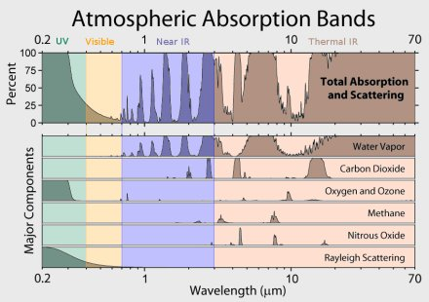
Atmospheric absorption
You should see that water vapour is mostly responsible for absorbing infra red.
Oxygen and ozone are responsible for absorbing most of the high frequency waves, i.e. ultra violet and x rays.
So where would be the best place to put a telescope that worked in the infra red, ultra violet or x ray region?

Slide 13
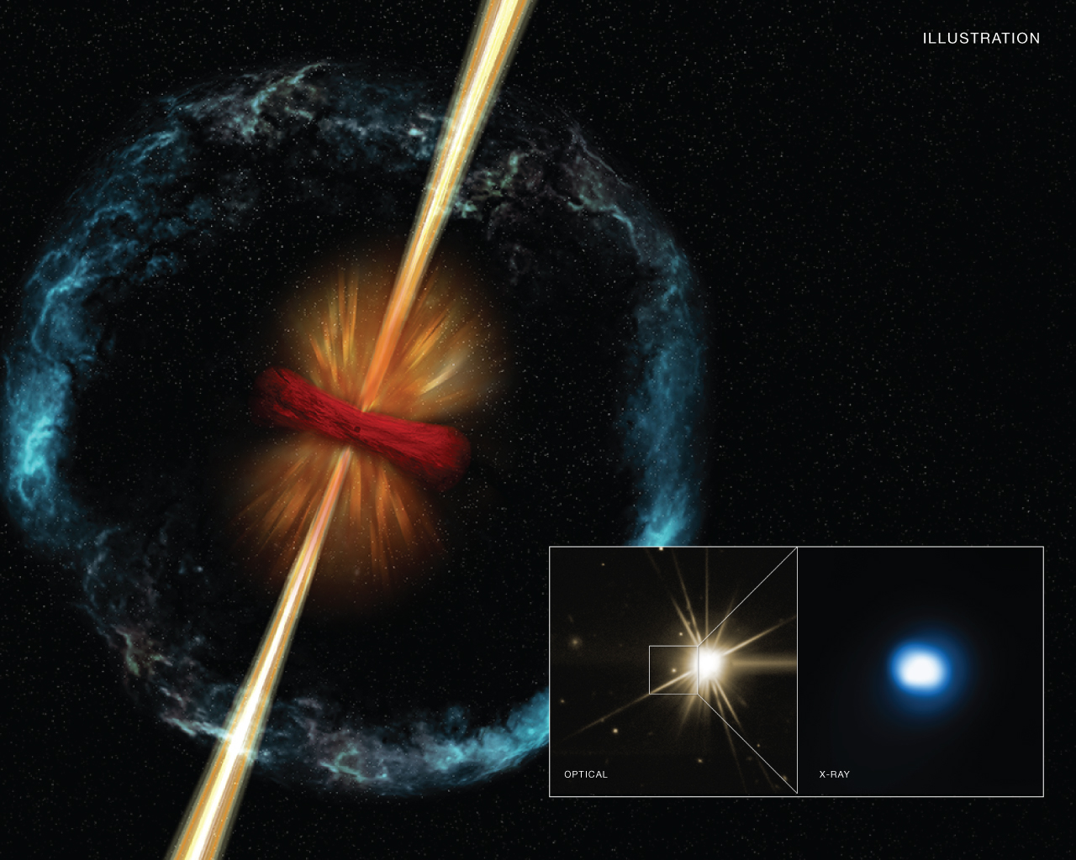
UV, x-ray and gamma ray astronomy:
Research some of the discoveries made at these wavelengths, including:
gamma ray bursts
accretion discs around black holes
corona and chromosphere structure of young stars.

Slide 14
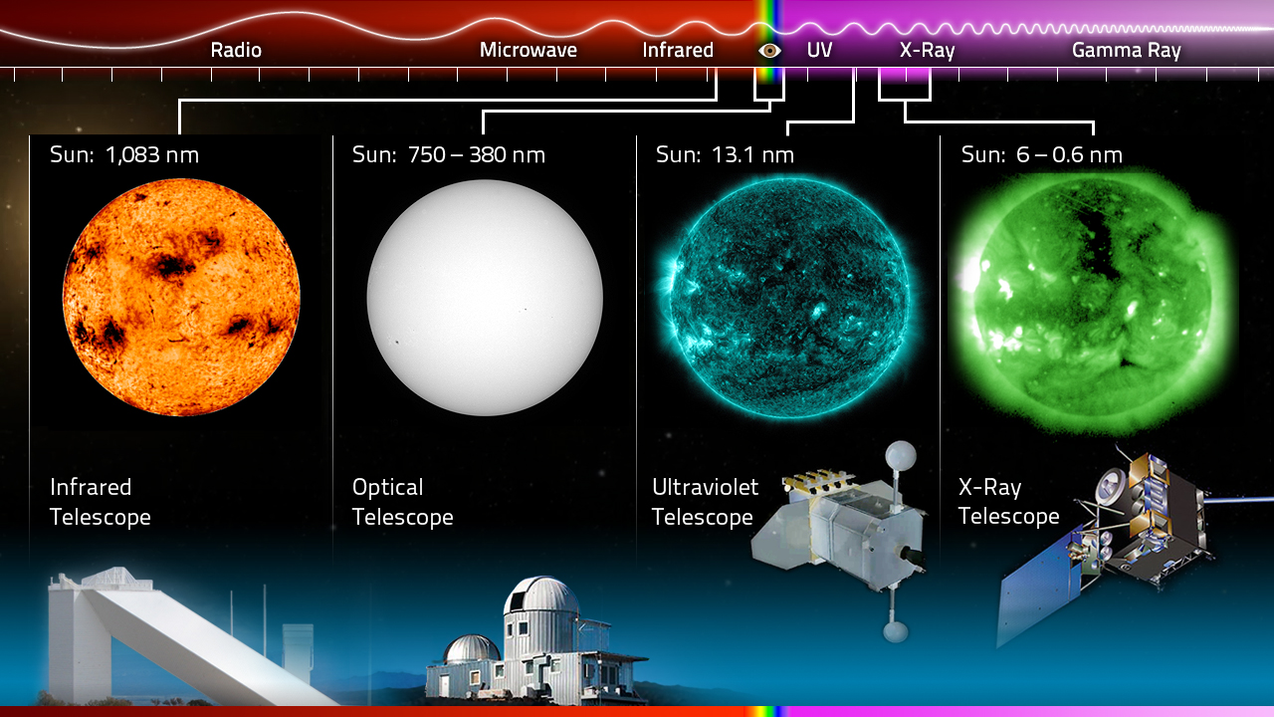
What does the Sun look like when observed in different regions of the electromagnetic spectrum.

Slide 15
