Slide 1
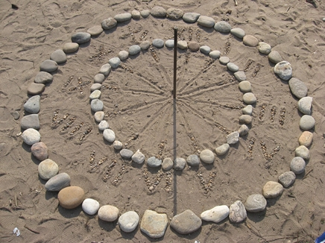
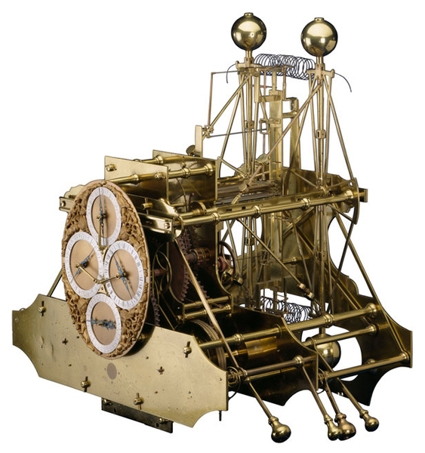
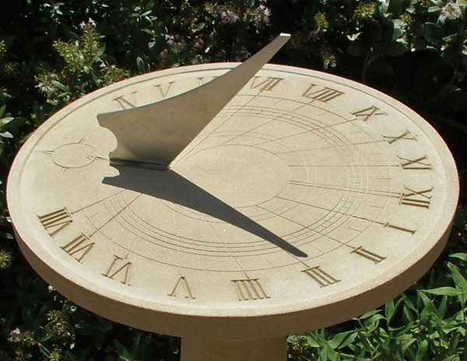
Sun Dials, Shadow Sticks and Chronometers
How do we tell the time? When is Noon?
When it is Noon in London what time is it in New York?

Slide 2
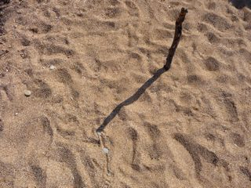
Shadow sticks
Describe what is observed from a shadow stick during the course of a sunny day.
ANIMATIONS: Shadow stick
Sun moves from east to west across sky. Shadows cast by opaque objects first become shorter then longer - Elevation of Sun increases to maximum (at local noon), when it crosses observer’s meridian (due south), and then decreases.
The position of the shadow also changes and this is used in a simple sundial.

Slide 3
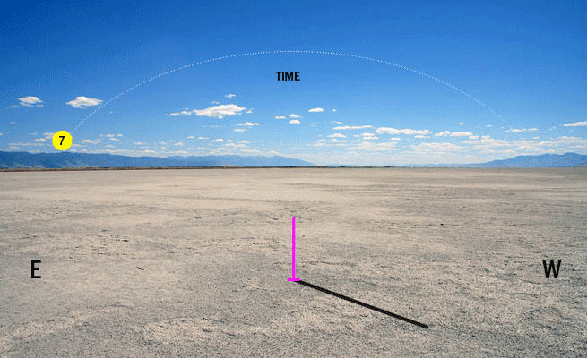
Shadow sticks
Describe what is observed from a shadow stick during the course of a sunny day.
ANIMATIONS: Shadow stick
Sun moves from east to west across sky. Shadows cast by opaque objects first become shorter then longer - Elevation of Sun increases to maximum (at local noon), when it crosses observer’s meridian (due south), and then decreases.
The position of the shadow also changes and this is used in a simple sundial.

Slide 4
Simple shadow stick can be used to determine time of local noon. If length of shadow cast by vertical stick is measured periodically (5 min?) for about half-an-hour either side of noon, then graph can be plotted of shadow length against time.
The length of the stick’s shadow becomes shorter before noon and longer after noon.

Slide 5
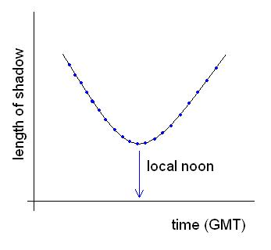
Shadow stick data
Time | Length of | Angle of
(GMT) | Shadow / cm | Shadow / º
10:50 | 18.3 | 326
11:00 | 18.0 | 331
11:10 | 17.8 | 336
11:20 | 17.6 | 340
11:30 | 17.2 | 342
11:40 | 16.8 | 345
11:50 | 16.6 | 350
12:00 | 16.6 | 352
12:10 | 16.5 | 355
12:20 | 16.4 | 000
12:30 | 16.4 | 004
12:40 | 16.7 | 007
12:50 | 16.8 | 011
13:00 | 17.0 | 014
13:10 | 17.2 | 017
13:20 | 17.6 | 021
Length of shadow /cm
11:00
11:20
11:40
12:00
12:20
12:40
13:00
13:20
13:40
10:40

Slide 6
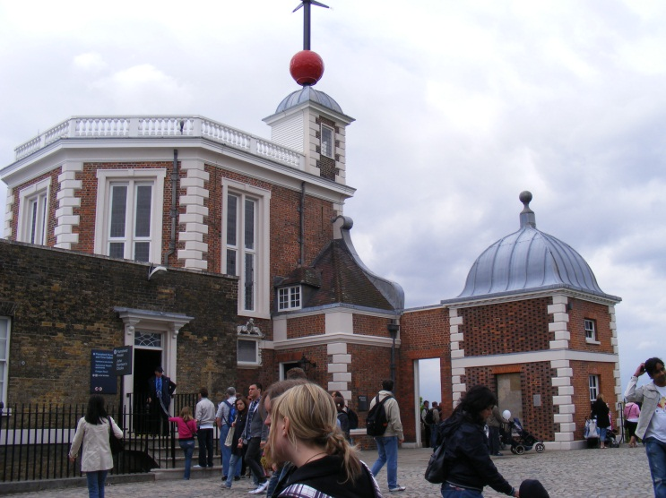
The longitude of Greenwich, or any location on the Prime (Greenwich) Meridian, is zero degrees. The Sun is highest in the sky from such a location at 12:00 noon AST. For every degree of longitude east or west of the Prime Meridian, the Sun is due south and reaches its highest point in the sky 4 minutes earlier than, or after, 12:00 noon (respectively).
1. A shadow stick casts its shortest shadow at 12:16 GMT. If the Equation of Time for that date is +4 min, determine the apparent solar time when the Sun appears highest in the sky.
2. On a day when the EOT is -7 min, a student notices that a stick casts its shortest shadow at 11:55 AST. What is the time GMT on the student’s watch?
3. At 12:08 AST, the Sun appears highest in the sky. What is the observer’s longitude?

Slide 7
1. A shadow stick casts its shortest shadow at 12:16 GMT. If the Equation of Time for that date is +4 min, determine the apparent solar time when the Sun appears highest in the sky.
SOLUTION
This is simply a case of using the EOT to determine apparent solar time (AST).
Since AST = EOT + GMT, we simply add 4 min to 12:16 to give 12:20.
Answer: 12:20 AST
2. On a day when the EOT is -7 min, a student notices that a stick casts its shortest shadow at 11:55 AST. What is the time GMT on the student’s watch?
SOLUTION
We simply use the EOT to determine GMT this time. Re-arranging the EOT gives
GMT = AST – EOT. Remembering to subtract a negative value for the EOT, this gives
GMT = 11:55 – (-7 min) = 12:02
Answer: 12:02 GMT
3. At 12:08 AST, the Sun appears highest in the sky. What is the observer’s longitude?
SOLUTION
The Earth rotates from west to east by 1 degree every 4 minutes. The Sun appears highest in the sky 8 min after noon and so this corresponds to 2 lots of 4 min i.e. 2 degrees west.
Answer: 2º W

Slide 8
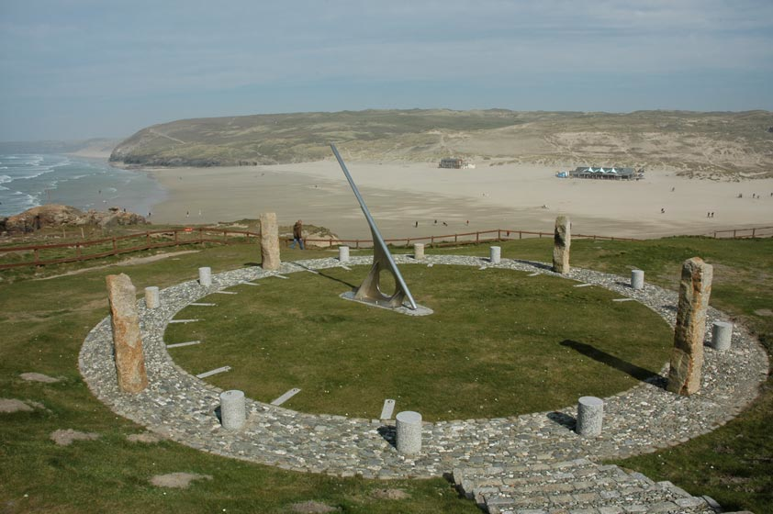
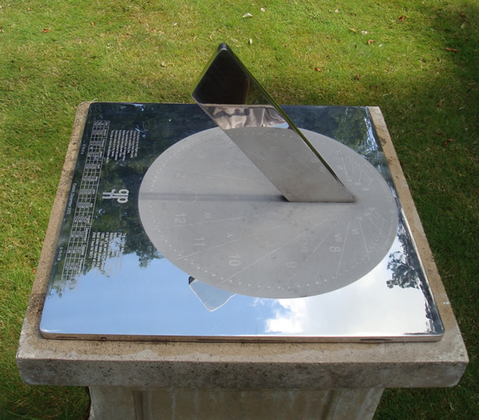
Sundials
Design and build a sundial

Slide 9
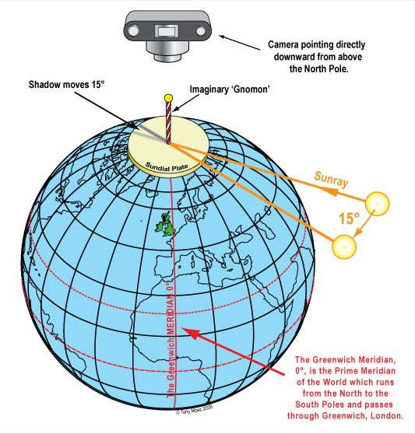
How Sundials Work
From the earliest times people have regulated their lives by the apparent motions of the Sun and the shadows cast by its rays. We say ‘apparent’ because of course it is the rotation of the Earth on its axis which causes the moving shadows we observe every day. When the Earth rotates 15° it is just as though the Sun had moved 15° around its daily track. Diallists use both conventions but it is usually easier to regard the Sun as being in motion. Perhaps the best place to begin an understanding of how sundials work would be to imagine a pictorial view of the Earth at the North Pole In this diagram it is the Sun which seems to move at 15° every hour. The shadow-casting element of a sundial is usually called the ‘gnomon’ of which the edges are its ‘styles’.

Slide 10
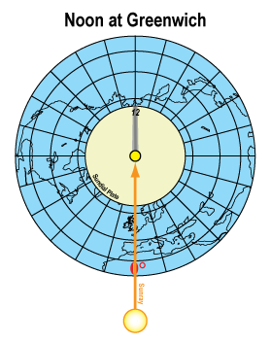
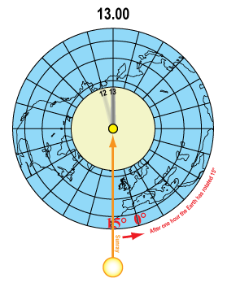
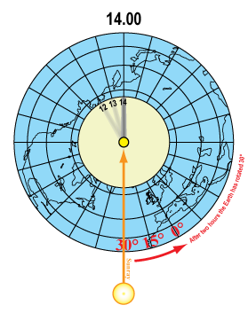
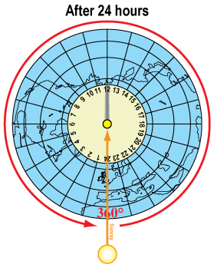
Polar view
Four views of the Earth as seen from the camera pointing downward from above the north pole. In these images the Earth is rotating with a stationary Sun.

Slide 11
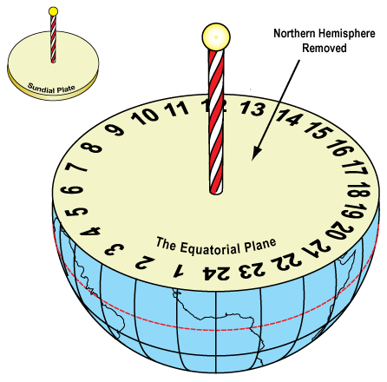
The Equatorial Sundial
It may be surprising that the sundial we visualized at the North Pole is actually referred to as an EQUATORIAL sundial. This is because it is parallel with the Plane of the Equator.

Slide 12
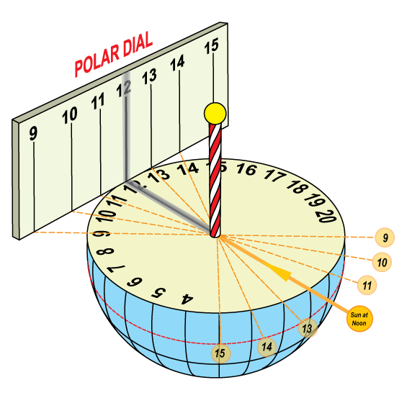
The Polar Dial
The Equatorial Dial is sometimes said to be the ‘Master Dial’ because it can be used to delineate many other kinds of sundial. This is done by projecting its hour lines onto any suitable receiving surface. The Polar Dial below is an obvious example.

Slide 13
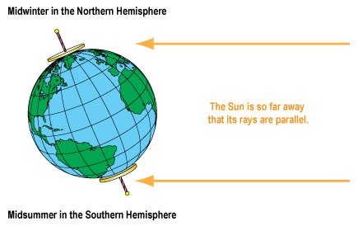
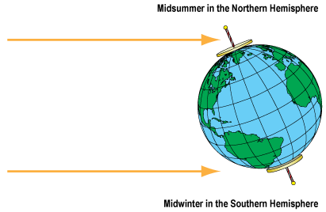
The axis of the Earth
Mid-winter in the northern hemisphere is when the Earth’s axis is tilted away from the Sun. The Sun never rises at the North Pole between October and March while at the South Pole the Sun never sets.
Mid-summer in the northern hemisphere is when the Earth’s axis is tilted towards the Sun. The Sun never sets at the North Pole between April and September while at the South Pole, the Sun never rises.

Slide 14
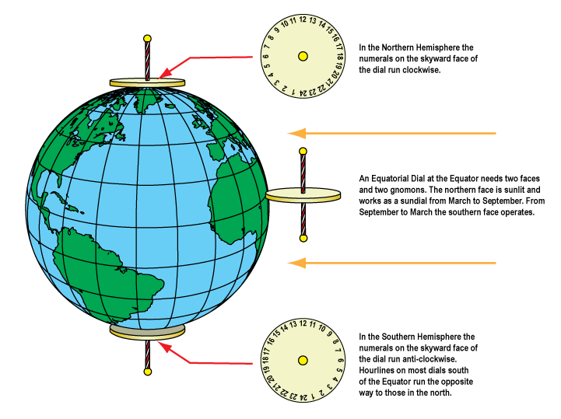
Dials at the poles and equator

Slide 15
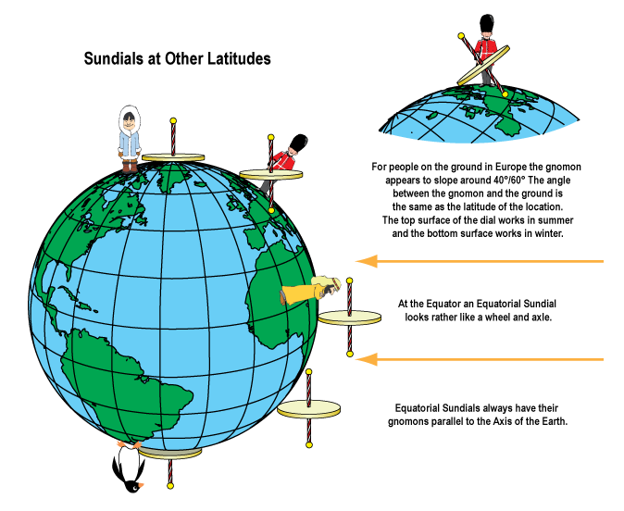
Dials at other latitudes

Slide 16
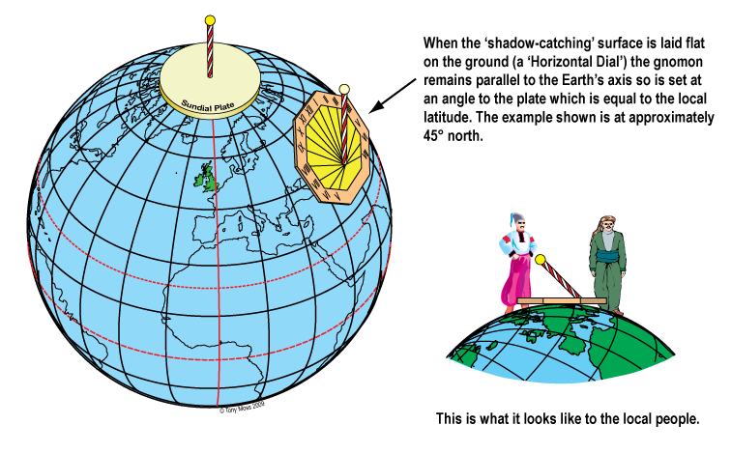
Horizontal dials at other latitudes

Slide 17
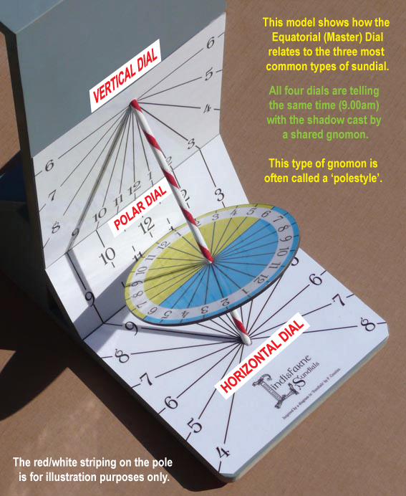
Multiple Dial

Slide 18
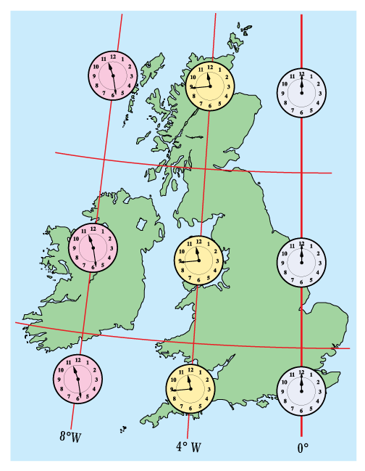
Solar Time, Correction for Longitude and Greenwich Mean Time (England)

Slide 19
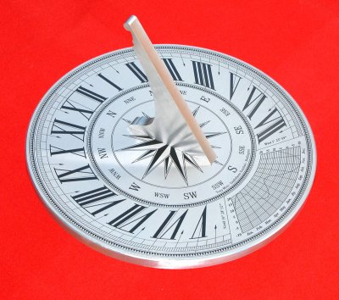
Horizontal Sundial with Equation of Time graph

Slide 20
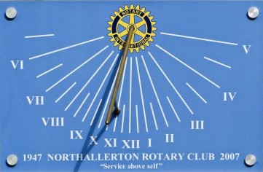
Declined Vertical Dial 54° 20' N, 1° 26' W. Declination 14° East

Slide 21
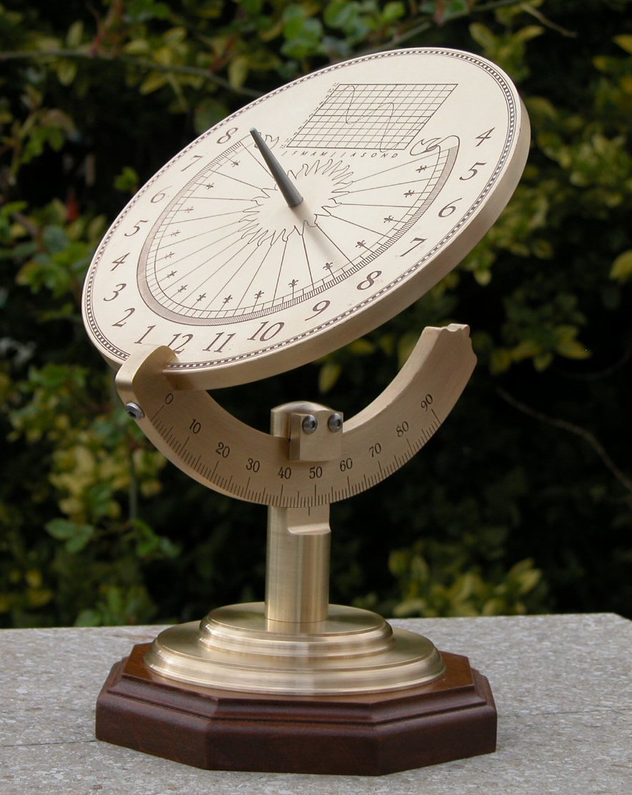
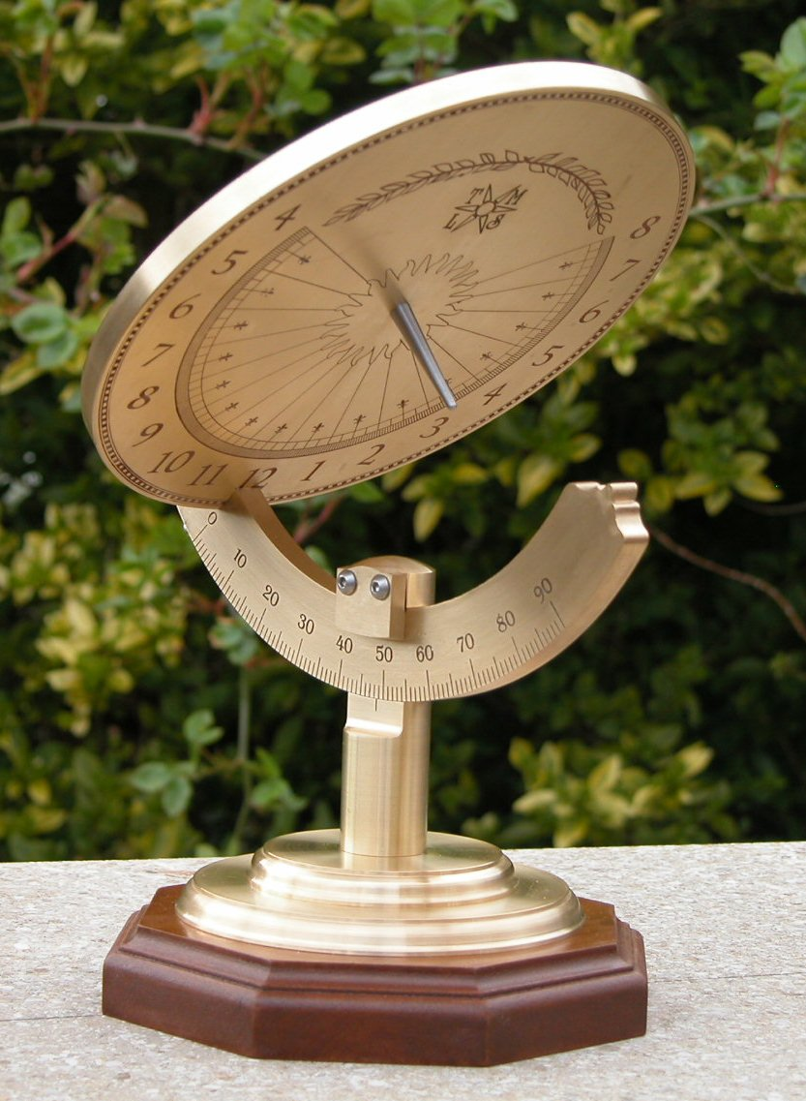
Universal Equatorial Dial. Adjustable for any Latitude
With Northern hemisphere summertime and wintertime faces

Slide 22
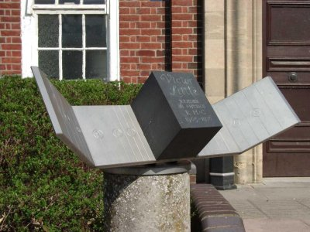
Polar Dial with cranked ‘wings’ to show hours from 6am to 6pm
Flat polar dials cannot show early and late hours

Slide 23
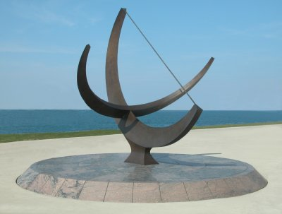
Bowstring Equinoctial Dial by sculptor Henry Moore
Adler Planetarium, Chicago

Slide 24
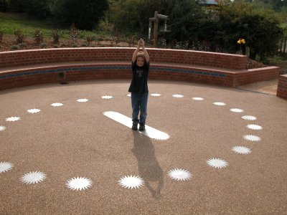
Analemmatic Sundial
If the user stands on the current date
on the central panel the shadow will show solar time

Slide 25
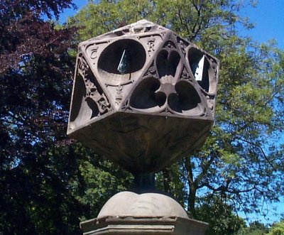
Polyhedral Sundial
Twenty equilateral triangular faces with several declined and ‘reclined’ (not vertical) dials on each face

Slide 26
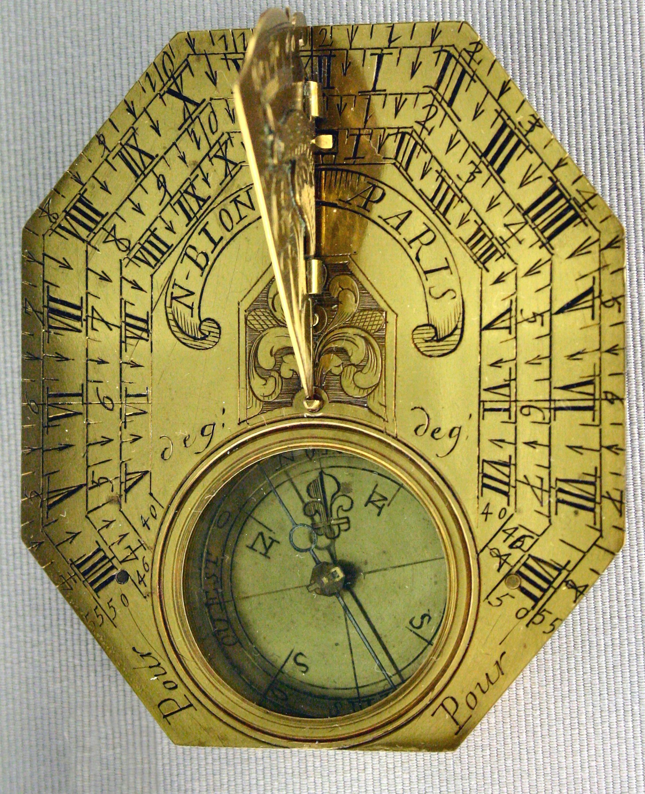
Portable Horizontal Dial

Slide 27
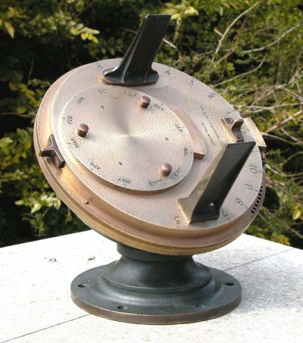
A Heliochronometer
Converts Solar Time to Clock Time

Slide 28
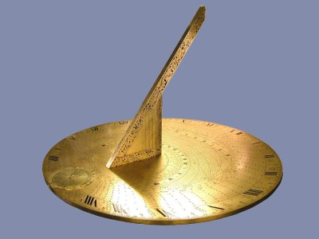
Double Horizontal dial
The sloped & vertical gnomons of this replica Double Horizontal
dial tell Sun time, Moon time and displays the Sun altitude & azimuth

Slide 29
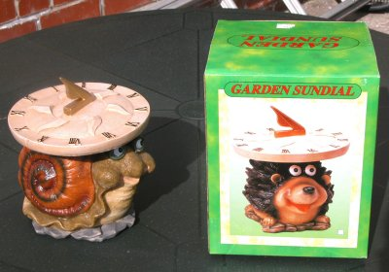
This ugly plastic ‘non-dial’ does nothing at all except display the ‘designer’s ignorance and persuade the general public that ‘real’ sundials don’t work

Slide 30
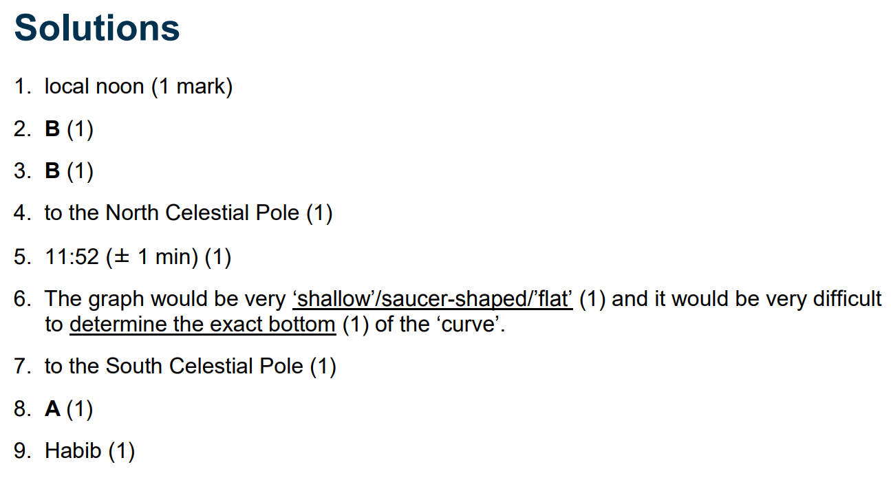
Worksheet Time

Slide 32
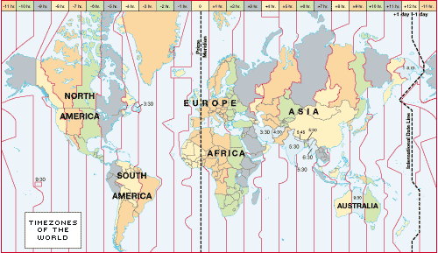
Time zones and international date line

Slide 33
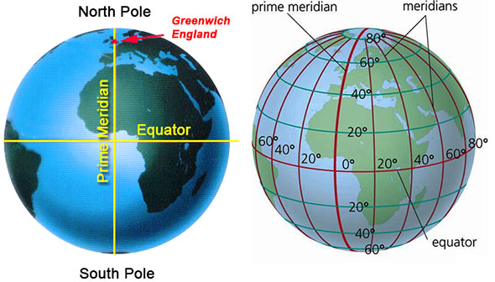
Time zones and international date line
In the time zone of the Greenwich or Prime meridian (0⁰ Longitude) the local Mean time IS Greenwich Mean Time GMT

Slide 34
GMT AND UTC
Universal Time (UT) is a time standard based on Earth's rotation. It is a modern continuation of Greenwich Mean Time (GMT), i.e., the mean solar time on the Prime Meridian at Greenwich, London, UK.
UTC is the time standard commonly used across the world. The world's timing centres have agreed to keep their time scales closely synchronized - or coordinated - therefore the name Coordinated Universal Time.

Slide 35
Atomic and Solar Time
Two components are used to determine UTC:
International Atomic Time (TAI): A time scale that combines the output of some 400 highly precise atomic clocks worldwide, and provides the exact speed for our clocks to tick.
Universal Time (UT1): Also known as astronomical time or solar time, it refers to the Earth's rotation. It is used to compare the pace provided by TAI with the actual length of a day on Earth.

Slide 36
Bringing it all together
So we can use the information we have learnt so far to determine our longitude with just a shadow stick and our friend the ‘Equation of Time’
Equation of Time = Mean solar time – Apparent Solar Time
If the EOT is negative then the AST must be behind the MST
If the EOT is positive then the MST must be behind the AST
An observer sees the Sun culminate at 11.56 GMT. The EOT on that date is -9. At what longitude is the observer located? Apparent solar time = Mean solar time + EOT Apparent solar time = 11.56 + -9 = 11.56 - 00.09 =11.47 4 minutes = 1 degree of longitude so 1 minute = 0.25 degree of longitude 13 minutes = 3.25 degrees As the amount is negative (greater than the apparent solar time) it is East. Positive would be West. = 3.25 degrees East
http://www.gcseastronomy.co.uk/space/earthmoonsun/eotcalculations.html

Slide 37
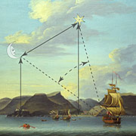
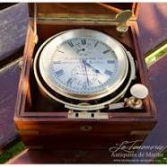
Determining Longitude
It was important for Maritime navigators to be able to determine their longitude so that they could know where they were and when they would arrive somewhere.
There were two main methods to do this:
The lunar distance method (Astronomical Method using the stars or moon)
The horological method using a maritime chronometer (accurate time piece) developed by John Harrison.

Slide 38
The lunar distance method (or lunars) was one of the means of determining longitude at sea that was made practicable in the 1760s.
The method used the moon's apparent motion relative to the stars like a clock to find a reference time (e.g. the time at Greenwich).
The difference between this time and local time on board the ship - determined from the sun - could be converted into a difference of longitude, one hour of time difference equating to 15 degrees of longitude.
This required accurate table of data about the moons position and a method of accurately observation form the deck of a ship using a Hadley quadrant or octant.

Slide 39
John Harrison designed an accurate time device in 1735 that could be used on ships to determine the longitude of a ship more precisely.
In 1714, the British government offered a longitude prize for a method of determining longitude at sea, with the awards ranging from £10,000 to £20,000 (£2 million to £4 million in 2018 terms) depending on accuracy.
Harrisons design was a clock based on a pair of counter-oscillating weighted beams connected by springs whose motion was not influenced by gravity or the motion of a ship.
Harrison went through several design stages H1, H2, H3, and H4 before perfecting an accurate and reliable device that is still in constant use today.

Slide 41
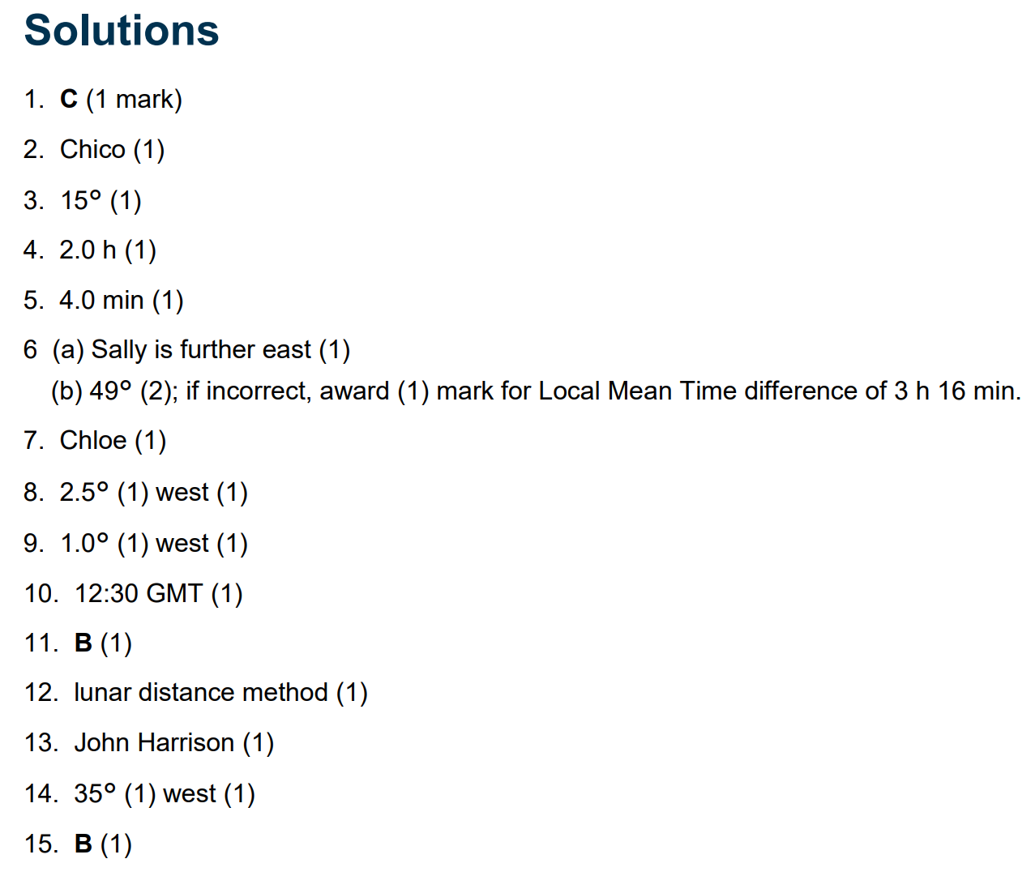
Worksheet Time

