Slide 1
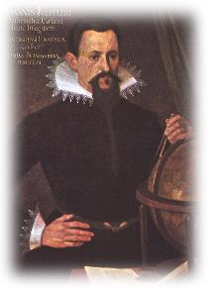
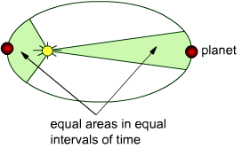
Kepler, Gravity and Newton
demonstrate an understanding that gravity is the force responsible for maintaining orbits and its inverse square law nature and study Kepler’s Third Law.
QUIZ ON Kepler’s Laws of Planetary Motion
Johannes Kepler was a German mathematician who explained the motion of the planets in three laws.
First Law of Planetary Motion: the orbits of the planets are ellipses.
Second Law of Planetary Motion: a planet moves more slowly when it is more distant from the Sun and faster when it is near it. (area swept out is equal in equal chunks of time)
Johannes Kepler (1571-1630)
Third law of Planetary Motion: provides an accurate description of the period and distance for a planet’s orbit about the Sun.
(the orbit of a planet around the sun squared is proportional to the distance from the sun cubed: T² α r³)

Slide 2
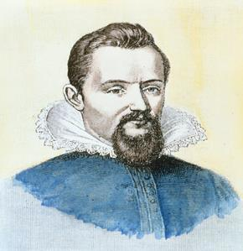
Kepler’s third law of planetary motion
It was Kepler who first established that the time period of an orbit is proportional to the cube of its radius.
The square of the period T of a planet is directly proportional to cube of its distance r away from the Sun
Kepler’s third law
T² α r³
Kepler derived his third law from experimental data in around 1605. There was no theory available at the time to account for it.
Johannes Kepler 1571–1630
It was Newton who was able to derive the full expression, using his theory of universal gravitation.

Slide 3
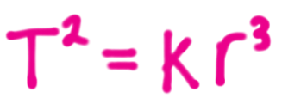
Kepler’s third law of planetary motion
$T^{2}=\frac{4 π^{2}}{G M} r^{3}$
This was discovered (empirically by Kepler, and later confirmed by mathematical theory by Newton, and is stated as Kepler’s 3rd law:

Slide 4
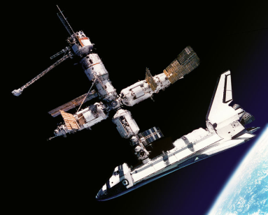
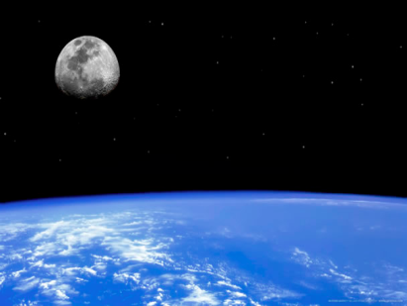
The mean distance from Mars to the Sun is 1.5 AU.
Calculate the orbital period of Mars. Use the formula T² = r³
Give your answer to 2 significant figures and state the unit.
Answer: √(1.5³) or 1.837 (1) 1.8 (2)
WORKSHEET TIME Kepler’s 3rd w/s

Slide 5
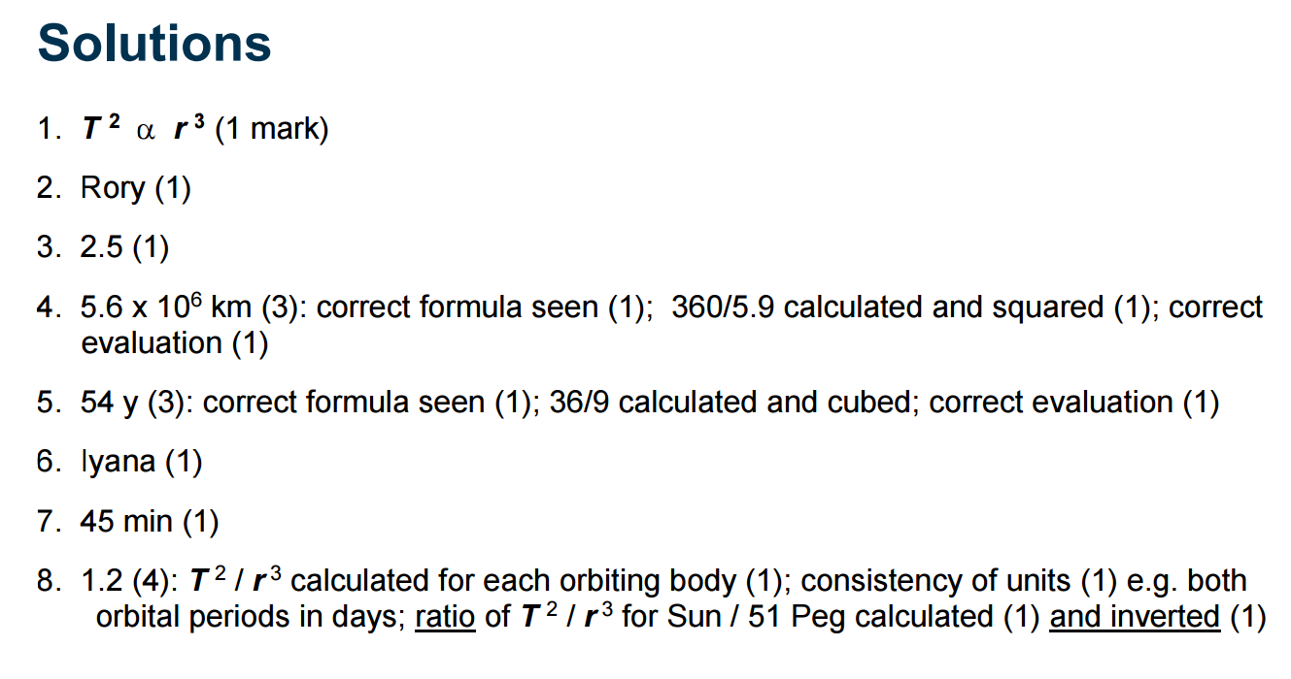

Slide 7
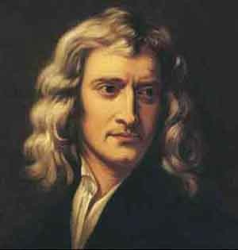
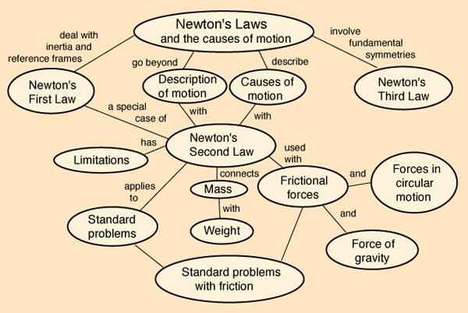
Newton made many great contributions to science. Produce a timeline showing some of the most significant contributions

Slide 8
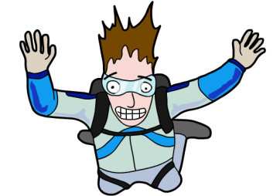
What is gravity?
Skydiver steps out of a plane. Which way does he move? Why?
Gravity is a universal force which attracts any mass to every other mass in the Universe.
Every mass has gravitational field.
Two objects (masses) to make a gravitational force.
Gravity is a very weak force ➔ small masses don’t stick together
If at least one object is very massive ➔ Effect of gravity can be seen
Skydivers always fall back to Earth!

Slide 9
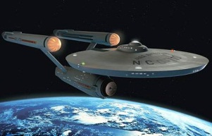
Factors affecting gravity
Bigger mass ➔ Stronger gravitational field
Further apart objects ➔ weaker gravitational forces
Gravitational force between two objects can be increased:
Increase size of either mass
Decrease distance between masses

Slide 10
Explaining orbits
Copy the diagram of Newton’s thought experiment and annotate it to explain what demonstrates about how orbits “work”.

Slide 11
Newton’s law of gravitation
‘If I have seen further, it is by standing on the shoulders of giants.’
Sir Isaac Newton
Gravitational constant
Masses attracting each other (kg)
Force of attraction (N)
F
F
Distance between masses (m)
The gravitational constant has a value 6.67 x 10⁻¹¹ Nm²/kg²
Tasks:
1) What happens to the gravitational attraction between 2 masses if…
a) one of the masses is doubled?
b) the distance between the masses is doubled?
2) Calculate the gravitational force that attracts the Moon to the Earth, given its mass is 7.35 x 10²² kg, the Earth mass is 6.0 x 10²⁴ kg, and the distance between their centres is 3.85 x 10⁸ m
3) Calculate the gravitational attraction between two people, with masses 60 and 70 kg respectively, standing 1 m apart. Who attracts who the most?

Slide 12
A journey from Earth to the Moon
TASK:
You are on a journey from the Earth to the Moon.
Describe how your “force sensor” readings change during your journey.
Is there any point where you will not feel a force pulling you one way or the other?
If so will you be closer to the Moon or Earth? Why?

Slide 13
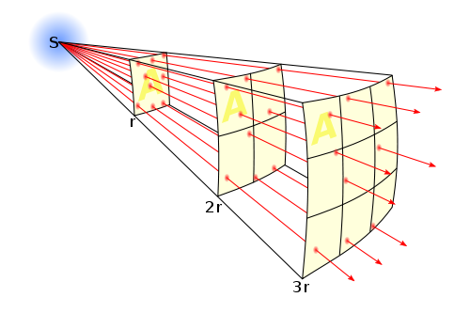
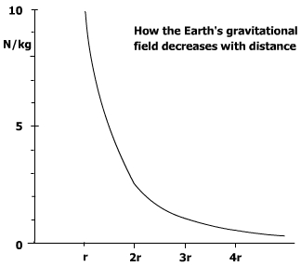
Gravitational field strength
As you move away from a planet its gravity becomes weaker.
As it varies with 1/r² when distance doubles the field strength will decrease by factor of 4
When distance triples the field strength will decrease by factor of 9, and so on
r is the radius of the earth
On Earth’s surface a 1 kg mass experiences force of 10 N
If distance is increased to 2r then the force experienced will become 10/4 = 2.5 N/kg
If distance is increased to 3r then the force experienced will become 10/9 = 1.1 N/kg
Calculate the size of the Gravitational field strength at a distance 4 times the radius of the Earth and add this to your graph

Slide 14
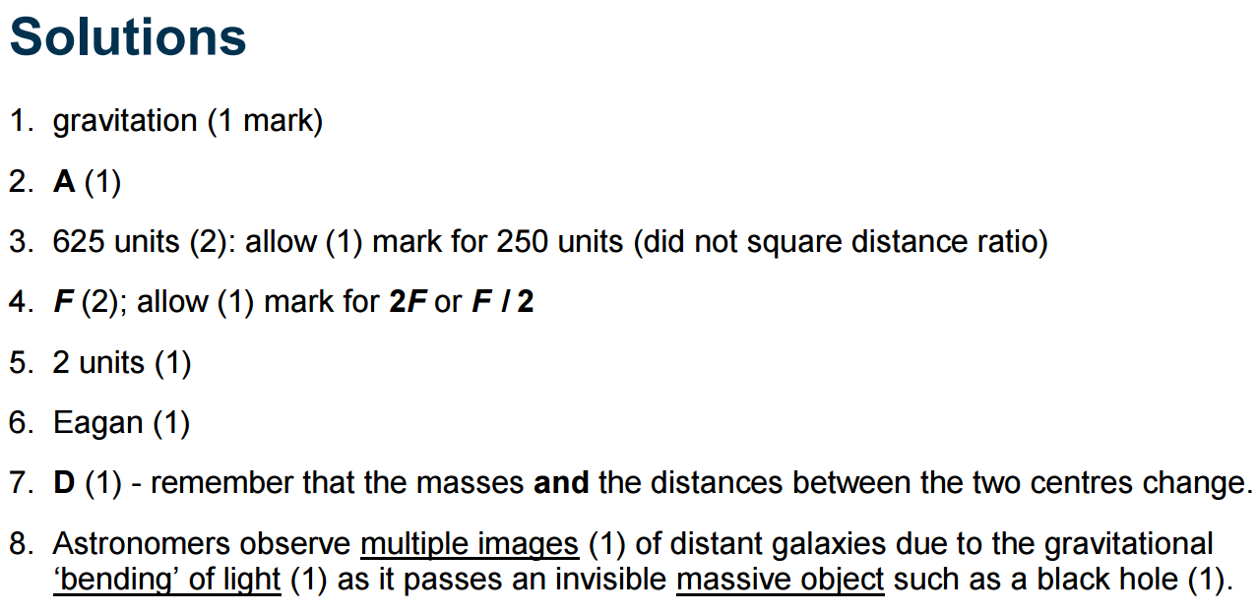
Gravitation Worksheet time

Slide 15
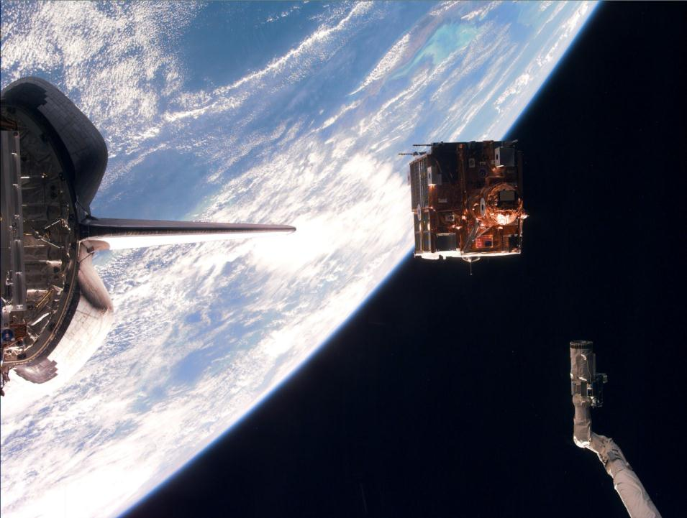
Man-made Satellites
Once in orbit, satellites are launched from the Shuttle’s cargo bay.

