Slide 1
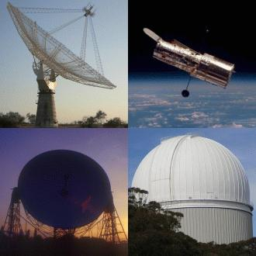
GCSE Astronomy – Topic 11 Exploring the Solar system 11.6 or 5.5 Optical Telescopes 2
Light Grasp
Aperture
Field of View
Resolution
Magnification

Slide 2
Pupils study the ‘light grasp’ of a telescope and how it relates to the telescope’s aperture (diameter of the objective element).
Pupils study the field of view of a telescope, measured in degrees or arcmin.
Pupils study the resolution of a telescope and that itis:
proportional to the diameter of the objective element
reduced by observing at a longer wavelength(IR and radio).
Pupils study and practise using the formula for the magnification of a telescope.
Pupils study the advantages of reflecting telescopes over refracting telescopes, in terms of:
chromatic aberration
very long focal lengths
large aperture objectives
use of multiple mirrors.
Pupils study how viewing celestial objects with a telescope alters their appearance.

Slide 3
Find out what the ‘light grasp’ of a telescope is and how it relates to the telescope’s aperture (diameter of the objective element).
Write two questions that could test your fellow pupils knowledge of this concept.
First question should be a simple statement answer the second should be an explain or describe type question.
Find someone to try out your questions on.

Slide 4
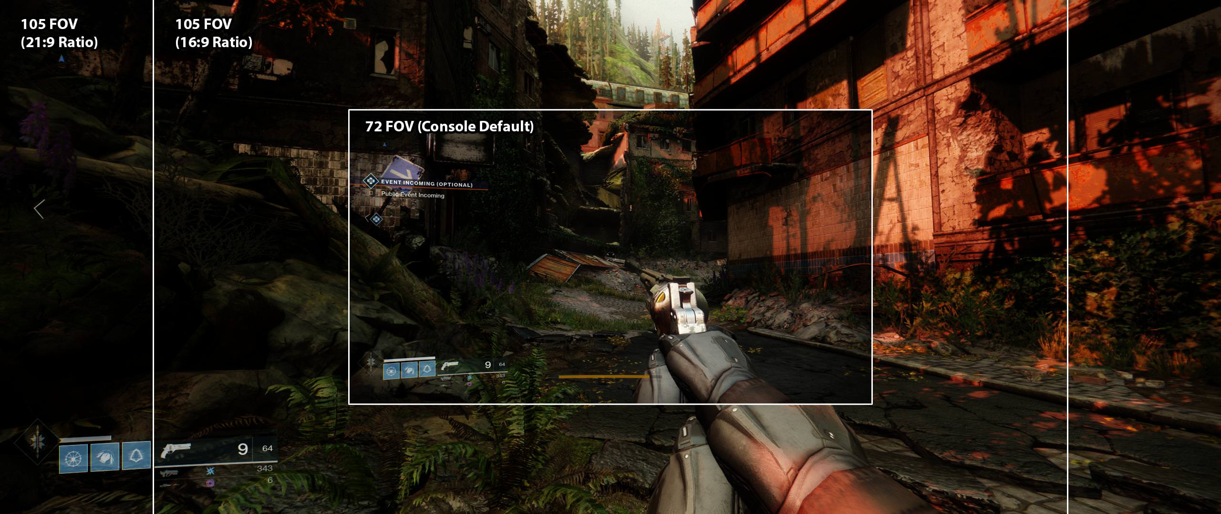
FoV and Resolution
What is the field of view of a telescope, why is it measured in degrees or arcmin?
Find out about the resolution of a telescope including why it is:
proportional to the diameter of the objective element
reduced by observing at a longer wavelength(IR and radio).

Slide 5
3. Telescopes
Three distinct types of telescopic power
Collecting Power (also called light gathering power or light grasp)
Magnifying Power
Resolving Power

Slide 6
1. Collecting Power
Collecting Power = the amount of light the telescope is able to focus into the eyepiece
The more light it collects, the brighter the image
Stars will always look like points of light, but you will be able to see more (fainter ones) and they will be brighter
This is the most significant factor
Explorations: An Introduction to
Astronomy, Thomas T. Arny, p. 155)

Slide 7
1. Collecting Power
Light-collecting ability varies with the square of the aperture.
Thus, a 90mm telescope (a little under 4”) collects only 1/5 as much light as an 8” telescope
Orion Catalogue

Slide 8
2. Magnifying Power
Magnifying Power = the number of times a telescope (or binocular) can increase the apparent size of an object.
8x, 100x, etc.
We’ll discuss how to calculate magnifying power later.

Slide 9
3. Resolving Power
Resolving Power = the ability of the instrument to discriminate fine detail.
How sharp or fuzzy the image is
The limitation on resolving power is imposed by the interaction of light and optics.
The quality of the optics is a major factor
Lens, mirrors, eyepieces, etc.
Usually, you get what you pay for
The turbulence in the air column you are looking through, moisture in the air, etc. also effect this.

Slide 10
3. Resolving Power
http://physics.uoregon.edu

Slide 11
Telescopes – Eyepieces
Your eye
An eyepiece brings the light rays gathered by the telescope into sharp focus.
The eyepiece determines the magnification, as well as its brightness and contrast
Orion Catalogue

Slide 12
Telescopes – Eyepieces
Eyepieces with shorter focal lengths (lower numbers) provide higher magnifications
Ex. 4 mm to 12 mm focal length
Images under high magnifications become more and more fuzzy, depending on the quality of the optics

Slide 13
Telescopes – Eyepieces
Eyepieces with longer focal lengths (larger numbers) provide lower magnification, but yield brighter, sharper images
Ex. 20 mm to 40 mm (wider angle)

Slide 14
Telescopes – Eyepieces
Eyepieces
Medium Lengths
13 mm to 19 mm
The author recommends having at least one low (20-40 mm) and one medium (12-19 mm) power eyepiece.

Slide 15
Calculating Magnification
Magnification = Telescope focal length
Eyepiece focal length
Telescope focal length = The distance from the center of a curved mirror or the center of the lens (where light passes through the first element of the telescope) to the focal point.
Orion AstroView
Meade LX200R
Orion Catalogue

Slide 16
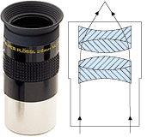
Calculating Magnification
Magnification = Telescope focal length
Eyepiece focal length
Eyepiece focal length = The distance from the center of the field lens (where light passes through the first element of the eyepiece) to the focal point.
Given in millimeters
ex. 25 mm, 14 mm, 7.5 mm)
Orion Catalogue

Slide 17
Calculating Magnification
Magnification = Telescope focal length
Eyepiece focal length
Examples
750 mm = 30x (my telescope)
25 mm
3048 mm = 122x (12” Meade)
25 mm
OR
750 mm = 100x (my telescope)
7.5mm
3048 mm = 406x (12” Meade)
7.5 mm

Slide 18
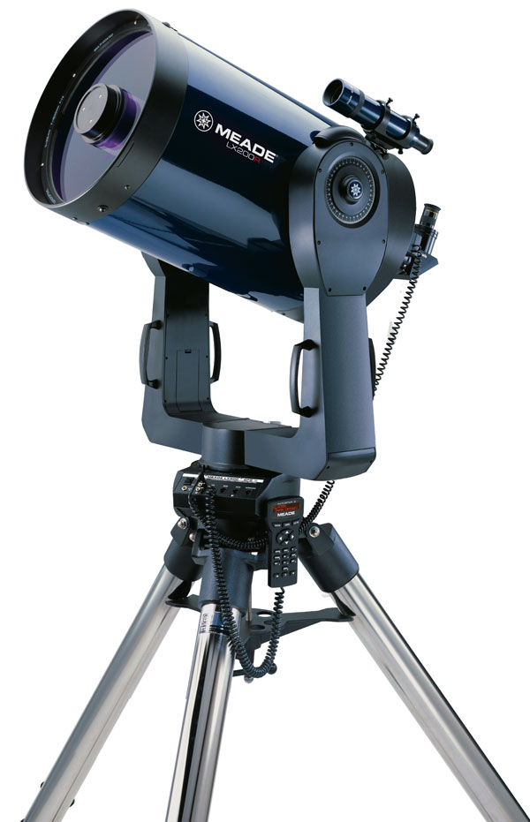
Calculating Magnification
Magnification = Telescope focal length
Eyepiece focal length
Eyepieces for Meade LX200R 12”
3048 mm = 117x
26 mm
3048 mm = 218x
14 mm

Slide 19
Calculating magnification
A telescope label 50x has a magnification power of 50.
It will make objects appear 50x closer (not necessarily 50x bigger.)
Distant stars are too far away to appear bigger, but a small telescope will increase the apparent distant between them making them clearer.

Slide 20
Calculating magnification
To work out the power of a telescope;
Focal length of objective lens
Magnification =
Focal length of eyepiece lens
50cm
Magnification =
5cm
Magnification = 10x

Slide 21
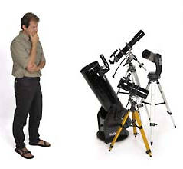
1. What is the magnification of a telescope with a 24-mm eyepiece
and 96-cm focal length objective?
2. How many times is the light grasp of a 12-inch telescope greater
than that of a 6-inch telescope?
3. How many times better is the resolution of a 12-inch telescope
compared with a 4-inch telescope?
4. What size of eyepiece (in mm) should be used with a 80-cm
focal length objective element to give a magnification of 40?
5. How many times is the light grasp of a 15-cm telescope
compared with that of a 5-cm telescope?
6. The field of view (FOV) of a telescope is 50’. What will be the
FOV (in ’) if the magnification is increased by a factor of 5?
7. What is the magnification of a telescope with a 30-mm eyepiece
and 90-cm focal length objective?
8. How many times is the light grasp of a 30-cm telescope greater
than that of a 6-cm telescope?

Slide 22
Answers to quick quiz
Telescopes
1. 40
2. 4
3. 3
4. 20
5. 9
6. 10
7. 30
8. 25

Slide 23
Worksheet Time
Have a go at the two worksheets
When you have finished try to determine what telescope you would recommend to someone if you had a £1000 budget to buy a telescope with.
Recommend the type of telescope and how much light grasp it has, what its aperture is and the FoV and resolution of your chosen telescope.

Slide 24
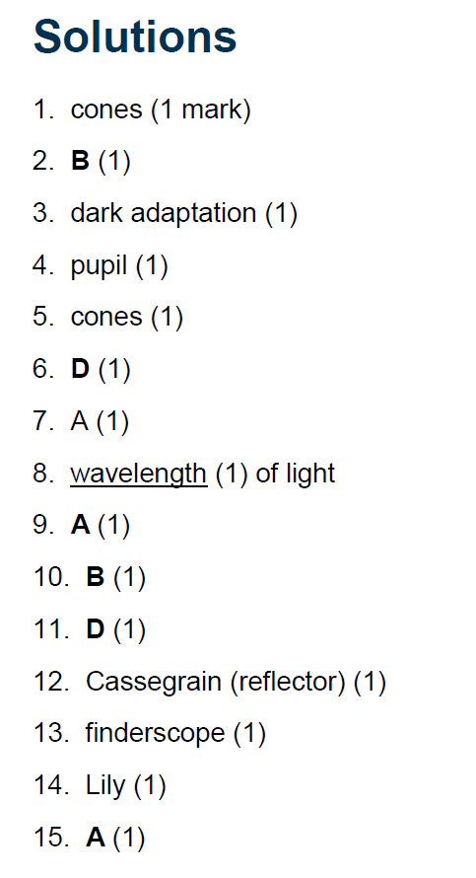
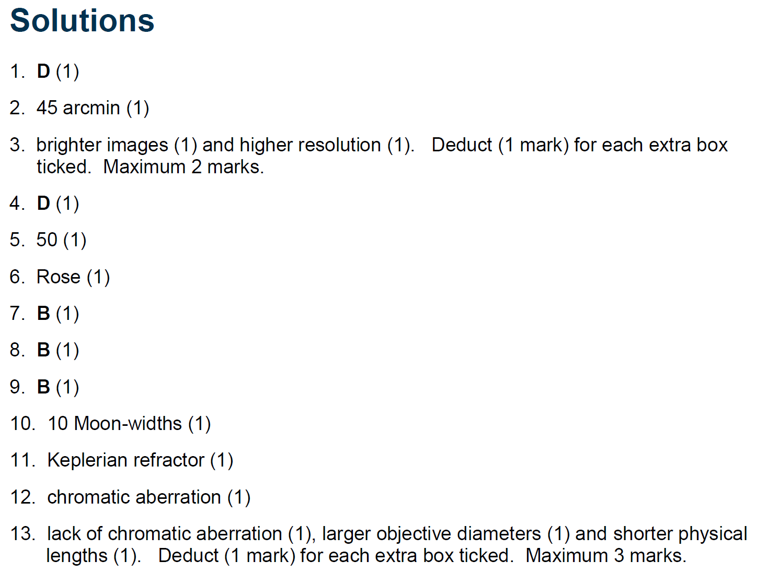

Slide 25
Telescopes
There are two main types of telescope;
Refracting telescope (Refractor)
This uses lenses to refract and focus the light.
Reflecting telescope (Reflector)
This uses curved mirrors to reflect and focus the light.

Slide 26
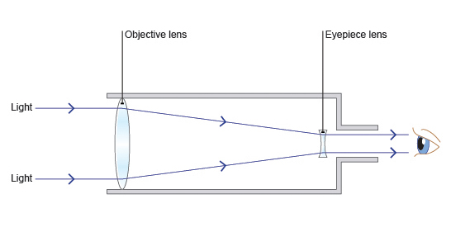
Refracting telescope
.
.

Slide 27
Telescopes
Refracting telescope (Refractor)
This uses lenses to refract and focus the light.
Eyepiece Lens
Objective Lens

Slide 28
Refracting telescope
A refracting telescope works bending light through a lens so that it forms an image. There are a few problems with refracting telescopes:
some of the light reflects off the lens so the image is very faint
large lenses are needed to improve the magnification – this can be difficult to do perfectly.

Slide 29
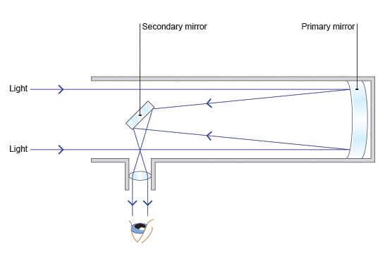
Reflecting telescope

Slide 30
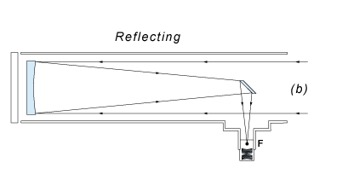
Telescopes
Reflecting telescope (Reflector)
This uses curved mirrors to reflect and focus the light.
Plane Mirror
Curved Mirror
Eyepiece Lens

Slide 31
A reflecting mirror.
How it works……
In a reflecting telescope
the image is formed by reflection from a curved mirror.
It is then magnified by a secondary mirror.

Slide 32
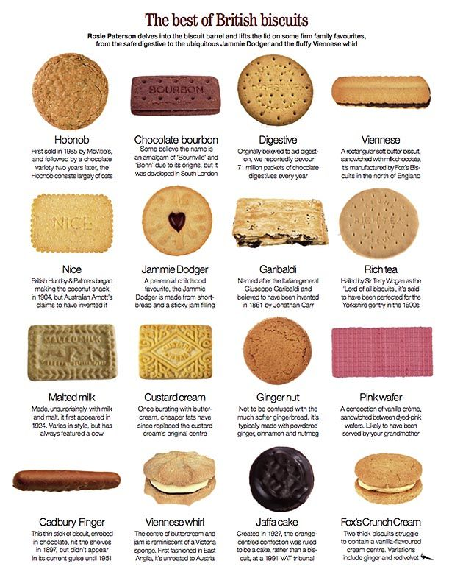
Types of telescope
Biscuit Task: Find out more about refracting and reflecting telescopes. Make a table to compare the advantages and disadvantages of both.
Draw or find a good picture of each type of telescope with the main components labelled and their functions described.

Slide 33
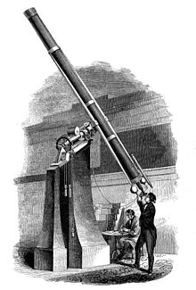
The first telescopes
The first known practical telescopes were invented in the Netherlands at the beginning of the 17th century, using glass lenses. They found use in terrestrial applications and astronomy.

Slide 34
Limitations of the human eye
Find out the reasons for using telescopes and why it is connected to the limitations of human eye sight.

Slide 35
Optical telescopes
Optical telescopes observe visible light from space. Small ones allow amateurs to view the night sky relatively cheaply but there are very large optical telescopes sited around the world for professional astronomers to use.
Optical telescopes on the ground can only be used at night and they cannot be used if the weather is poor or cloudy.

Slide 36
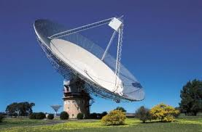
Radio telescopes
Radio telescopes detect radio waves coming from space. Although they are usually very large and expensive, these telescopes have an advantage over optical telescopes.
They can be used in bad weather because the radio waves are not blocked by clouds as they pass through the atmosphere. Radio telescopes can also be used in the daytime as well as at night.

Slide 37
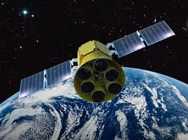
Earth Orbiting telescopes
Objects in the universe emit other electromagnetic radiation such as infrared, X-rays and gamma rays.
These are all blocked by the Earth's atmosphere, but can be detected by telescopes placed in orbit round the Earth.

Slide 38
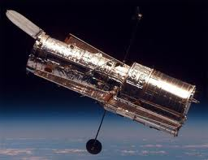
Space telescopes
Telescopes in space can observe the whole sky and they can operate both night and day. However, they are difficult and expensive to launch and maintain. If anything goes wrong, only astronauts can fix them.

Slide 39
Research task:
Research the optical elements of refracting and reflecting telescopes in further detail, and study the basic designs of:
Keplerian refracting telescope
Galilean refracting telescope
Newtonian reflecting telescope
Cassegrain reflecting telescope.

Slide 40
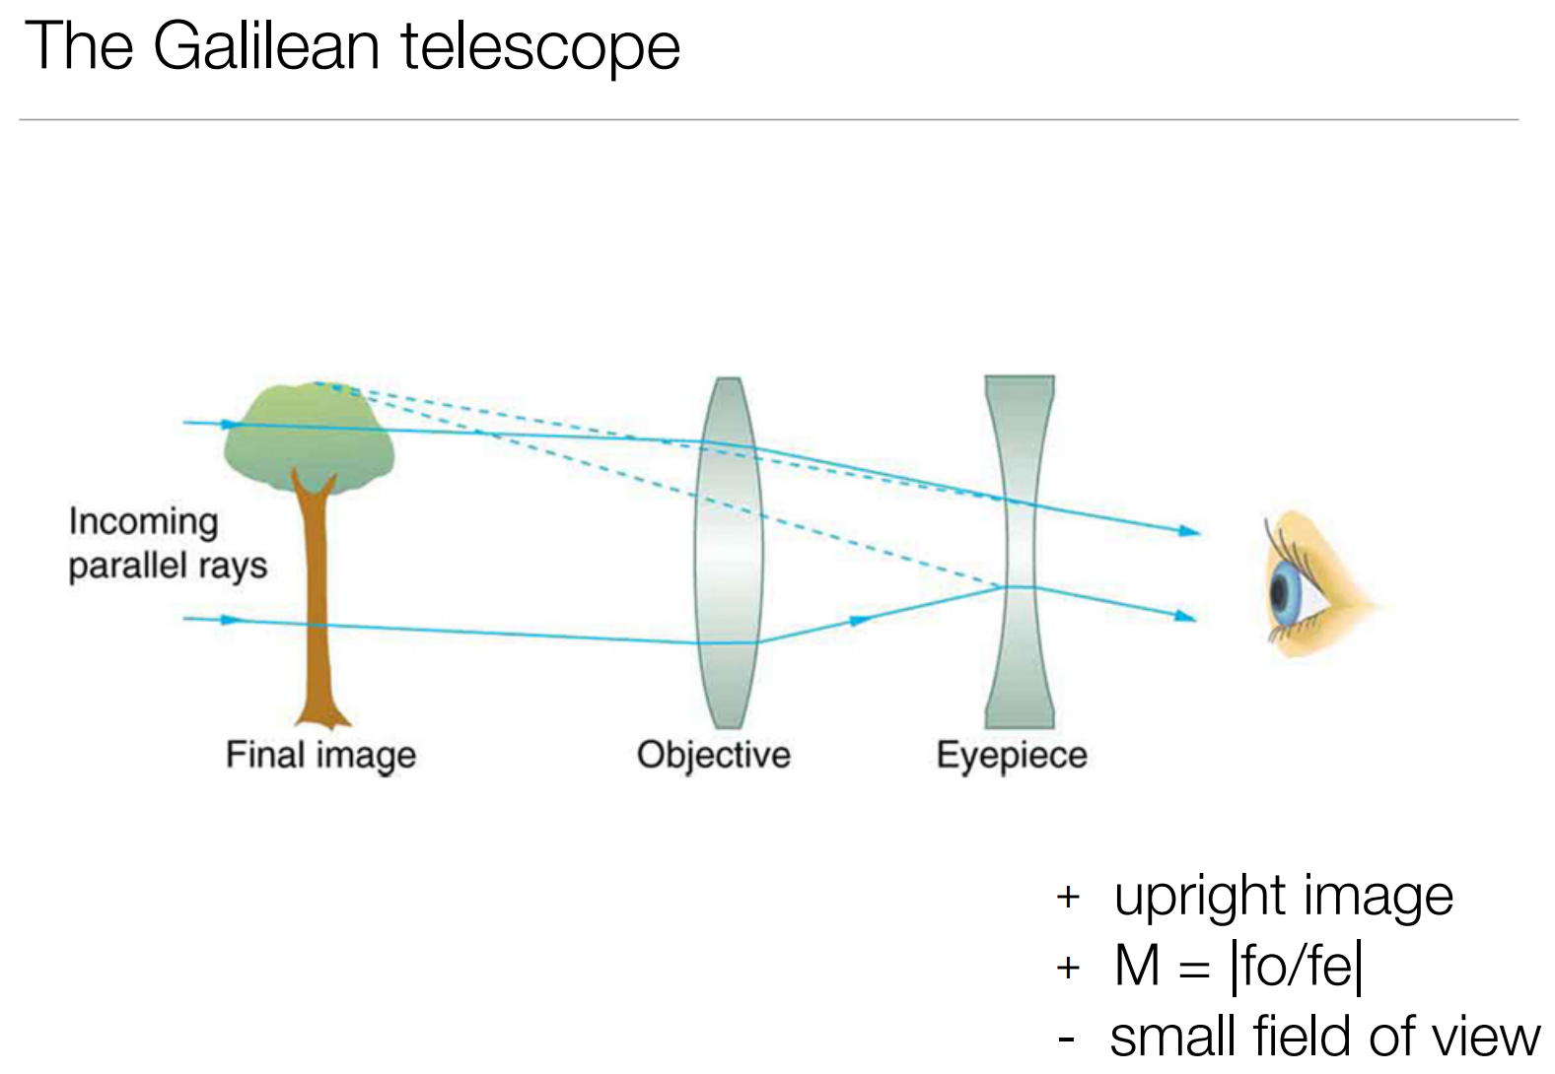

Slide 41
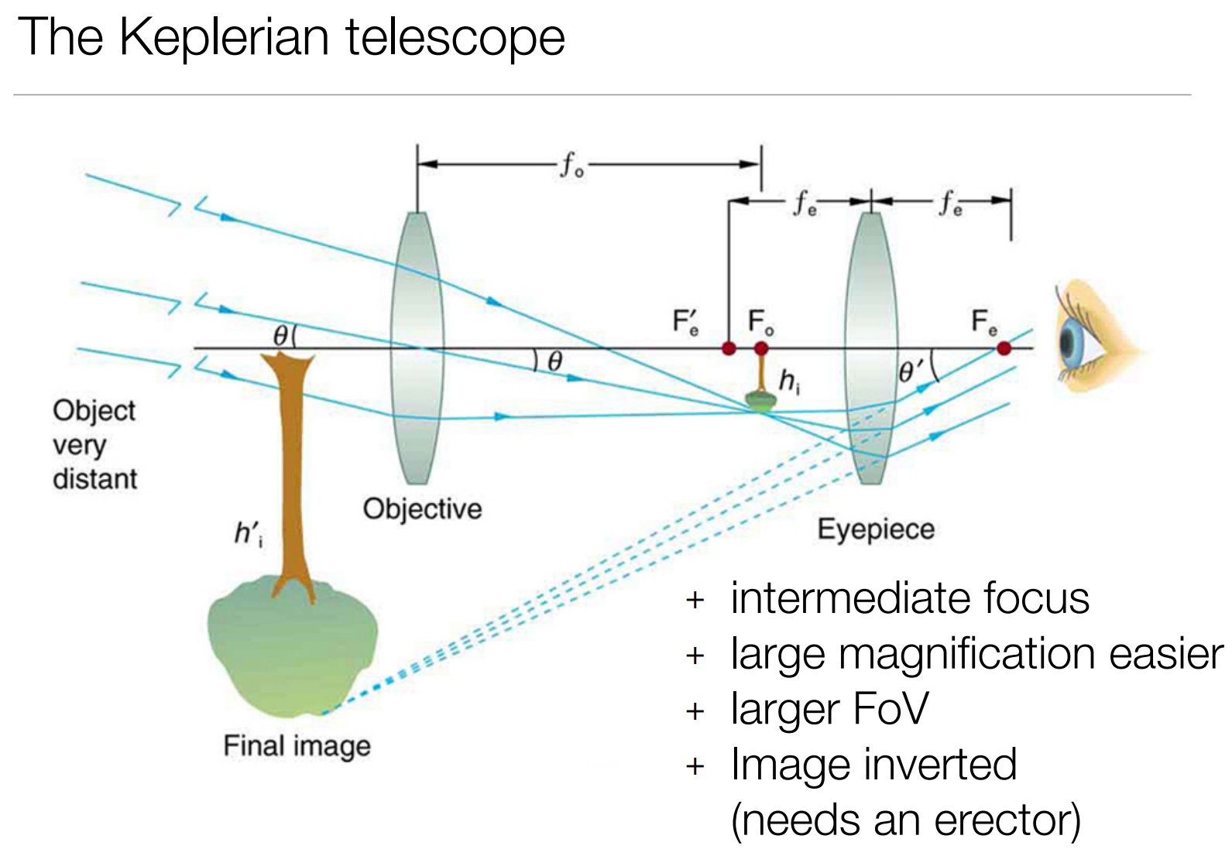

Slide 45
Telescopes
WALT: To understand advantages and disadvantages of using different types of telescope on Earth and in space.
To know why scientists make observations and deductions about the universe.
WILF:
Name four different types of telescope and describe how they can be used. (Grade C)
To compare the advantages and disadvantages of using each type of telescope. (B)
To explain in detail how telescopes use electromagnetic radiation including X-rays, infrared, gamma waves, visible light etc. (A/A*)

