Slide 1
Astronomy Topic 4
Revision Booster

Slide 2
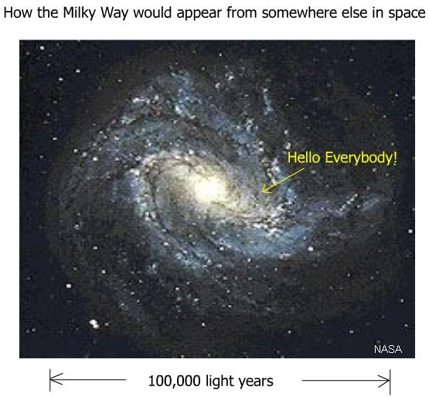
Milky way facts
200 billion stars
250 million years to orbit
One of a group of about 30 galaxies (The local group)

Slide 3
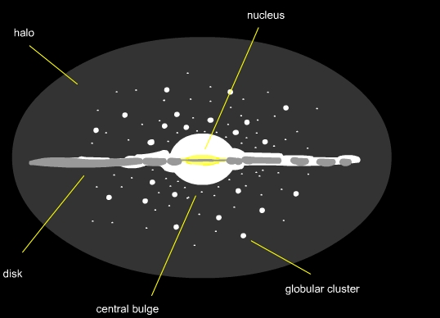
Open clusters – where stars are born, in the disc
Globular clusters – groups of very old stars, in the halo

Slide 4
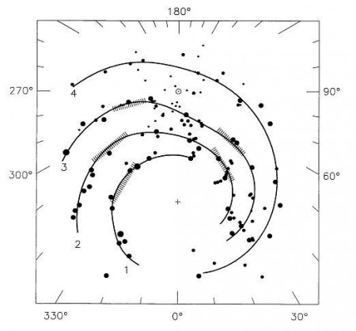
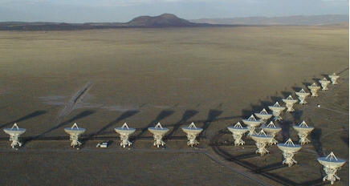
Mapped using 21cm radio waves. These can get through the huge amounts of dust

Slide 5
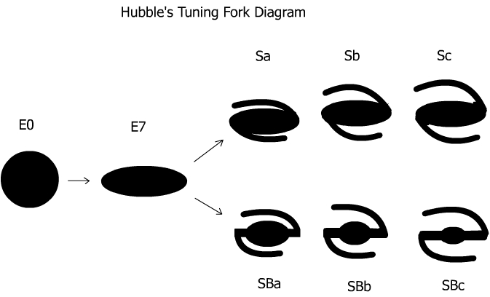
The Milky Way is an SBc type galaxy
There are also irregular galaxies

Slide 6
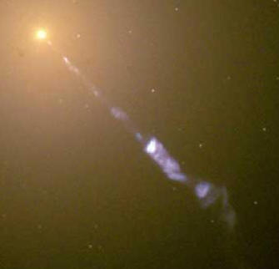
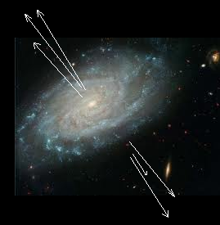
Galaxies emit all kinds of radiation, not just visible
Active galactic Nuclei
Stuff spirals (the accretion disc) around a supermassive black hole in the centre
This emits X rays
Some stuff bounces off due to shock waves causing jets of matter

Slide 7
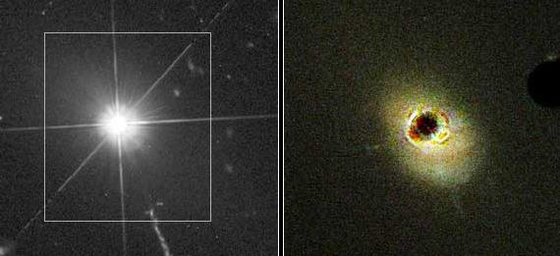
Quasar galaxies
very big, very old, very bright, very far away, massive red shifts, very active
Seyfert Galaxies
These emit light from excited gas surrounding the nucleus
Blazers
The amount of radiation we detect varies. They are on their side relative to us so there is a lighthouse effect” as they rotate

Slide 8
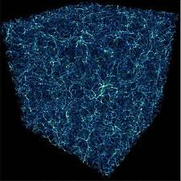
The structure of the Universe
Galaxy --> Group --> Cluster --> Super Cluster --> Universe
Ours includes Andromeda, Triangulum and the large and small Magellanic clouds
Ours is the Virgo super cluster, there are millions of others

Slide 9
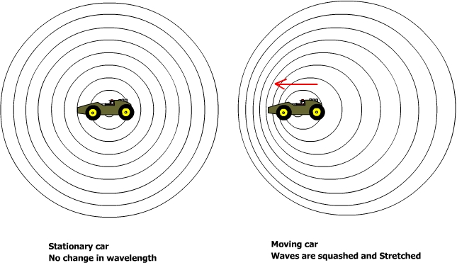
Light from distant galaxies is red-shifted
The light waves are stretched so that their wavelength is bigger

Slide 10
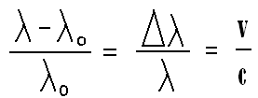
Change in wavelength
Recession velocity of the galaxy
The speed of light
Original wavelength
We can use the red shift to calculate the recession velocity
Andromeda shows a blue shift. Why?

Slide 11
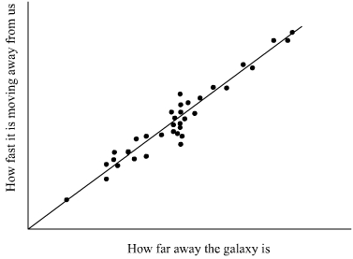
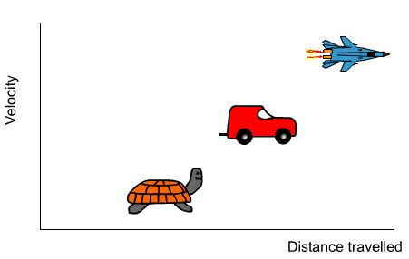
Hubble’s Law
Recession velocity = H x distance ( R = H d )
H is the gradient known as Hubble’s Constant
From the gradient of the graph we can calculate the age of the Universe
Age = 1 / H
About 13.6 billion years

Slide 12
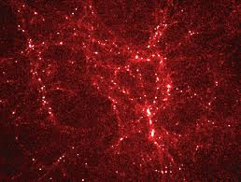
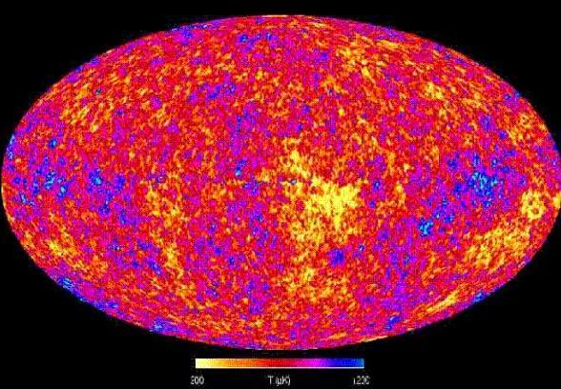
When the Universe was much younger (about 300,000 years old) and much hotter atoms first formed and lots of U.V. radiation was produced
This radiation is still detectable. It is much weaker and it has been red shifted so it is now microwave. We call it Cosmic Microwave Background Radiation.

Slide 13
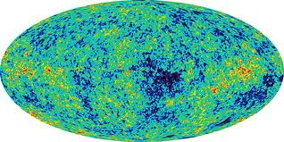
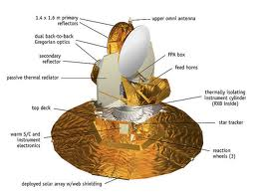
CMBR was discovered by accident by two telephone engineers
The probe WMAP has mapped this radiation accurately.
Variations in its strength tell us much about the early universe

Slide 14
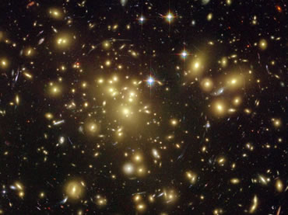
There is much more out there than we can’t see
What we can’t see is called Dark Matter (23%) and Dark Energy (72%)
We know very little about it

Slide 15
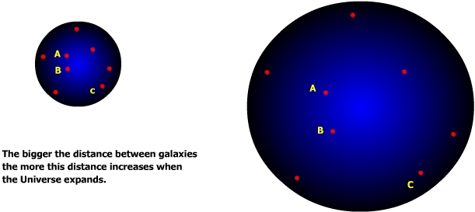
The Universe is expanding
Just like a firework galaxies further away are moving away from us faster
Many scientists believe the Universe started with a Big Bang
They believe it will keep expanding for ever
Because of outward pressure due to dark energy they believe the rate of expansion is actually increasing

