Slide 1
Astronomy Topic 3
Booster

Slide 2
Constellation – a part of the sky. There are 88
Asterism – a pattern of stars in the sky, e.g. the Plough
Open cluster – a group of young stars in the disc, e.g. the Pleiades
Globular cluster – a group of old stars in the Halo
Nebula – a cloud of gas and dust

Slide 3
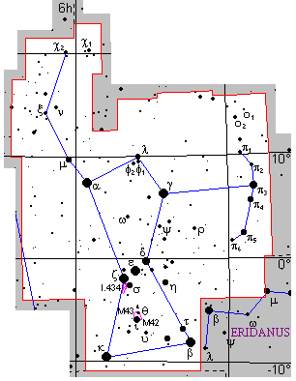
Greek letters are used to put stars in order of brightness
Alpha α
Beta β
Gamma γ
Delta δ
Epsilon ε

Slide 4
You must recognise these

Slide 5
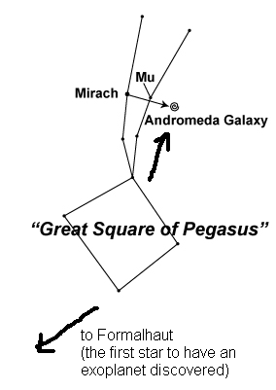
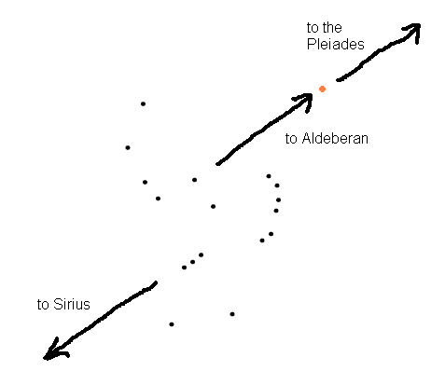
Pointers

Slide 6
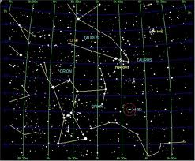
Summer | Winter | All Year
Sagittarius Scorpio Capricorn | Orion Gemini Taurus | Ursa Major Cassiopeia Cepheus
If the Sun is in a constellation then it is not visible at night
The Sun is in Taurus in the summer so Taurus is best viewed in winter

Slide 7
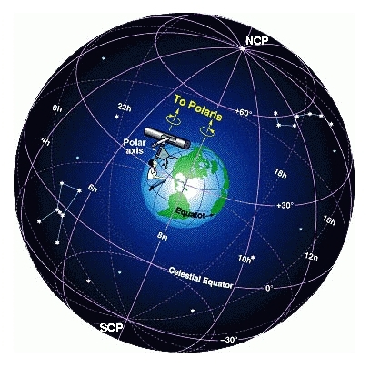
The Declination of a star is its angle in degrees above the celestial equator
The Right Ascension of a star is its “angle” east or west of the celestial prime meridian
It is measured in hours and minutes

Slide 8
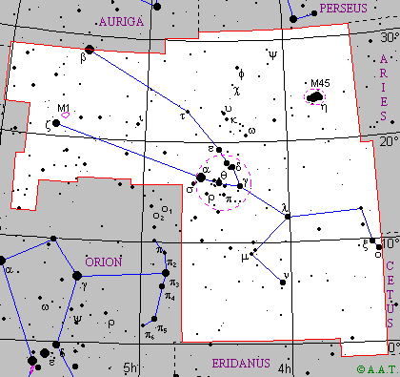
Charles Messier catalogued 110 objects
This is one of them
Aldeberan (α Tauri)
R.A. = 4h 34mins
Dec. = 16⁰

Slide 9
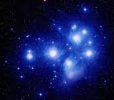
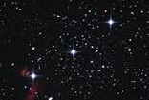
True binaries
Stars close together that influence each other gravitationally
Optical Binaries
Stars close together in the sky but at very different distances from us

Slide 10
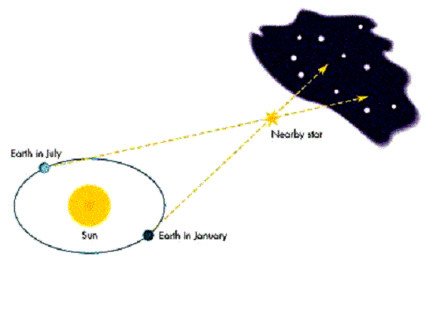
When we look at a nearby object from different angles it appears to move against a distant background
This is called parallax
Nearby stars appear in different positions during the year for this reason.
By measuring the angle we can calculate their distance
1 parsec = the distance that would produce a parallax angle of 1/60th of a degree
1 parsec = 3.2 light years

Slide 11
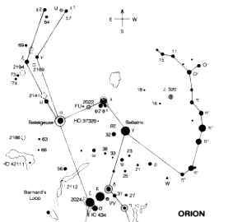
According to Hipparchus the apparent magnitude m of a star is from 1 to 6
Very bright star m =1 Very dim star m = 6
But m=1 stars are 100 x brighter than m=6
So a difference in m of 1 actually means a difference of 2.5 times (Pogson’s Ratio)
If α Orionis is 2.1 and another star is 3.1 then α Orionis is 2.5 times brighter

Slide 12
The apparent magnitude of a star depends on:
a) How far away it is b) how luminous it actually is
To compare the brightness of all stars they would have to be at the same distance from Earth. We define absolute magnitude M as follows

Slide 13
If we know m and d (distance in parsecs) we can calculate M
M = m + 5 - 5 log₁₀d
e.g.
if m = 11.6 and d = 1,000
Then
M = 11.6 + 5 – (5 x 3) = 1.6
( in any question you get d will always be 100 or 1,000 or 10,000 etc
Log₁₀d is just how many zeros there are so log₁₀ 1,000 = 3 )

Slide 14
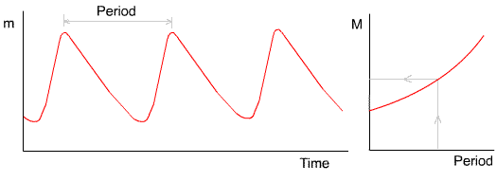
In most stars gravity and radiation pressure are balanced
In Cepheid variables they are not and the star pulses in brightness
If we measure the period of this variation we can calculate M
If we know M we can calculate how far away it is
A very useful technique for finding distances to galaxies

Slide 15
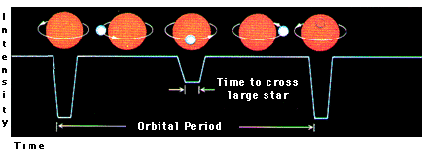
This is the light curve for an eclipsing binary
A large dim star and a small bright star

Slide 16
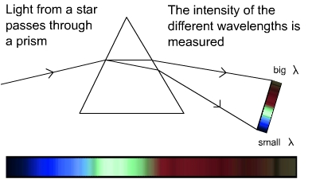
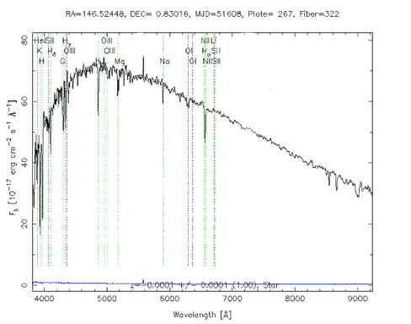
Stellar Spectra
From the spectrum of a star we can work out
Its age
Its temperature
What elements it contains
Its size
What kind of star it is

Slide 17
Classifying stars
Class | Spectrum | Colour | Temperature
O | ionized and neutral helium, weakened hydrogen | bluish | above 31,000 K
B | neutral helium, stronger hydrogen | blue-white | 9750-31,000 K
A | strong hydrogen, ionized metals | white | 7100-9750 K
F | weaker hydrogen, ionized metals | yellowish white | 5950-7100 K
G | still weaker hydrogen, ionized and neutral metals | yellowish | 5250-5950 K
K | weak hydrogen, neutral metals | orange | 3800-5250 K
M | little or no hydrogen, neutral metals, molecules | reddish | 2200-3800 K
Remember hot stars are blue, cooler stars are red

Slide 18
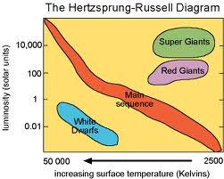
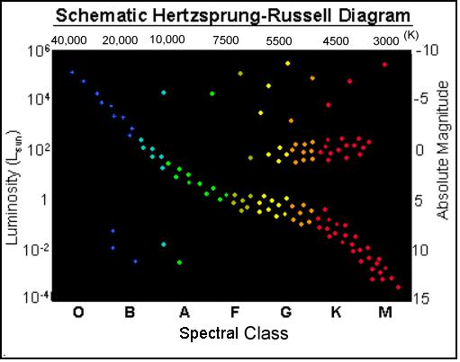
Where are these?
Red giants
Supergiants
Main sequence stars
White dwarfs
Where is the sun?

Slide 19
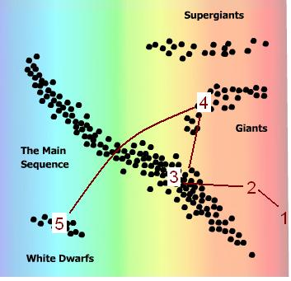
The life cycle of our sun

Slide 20
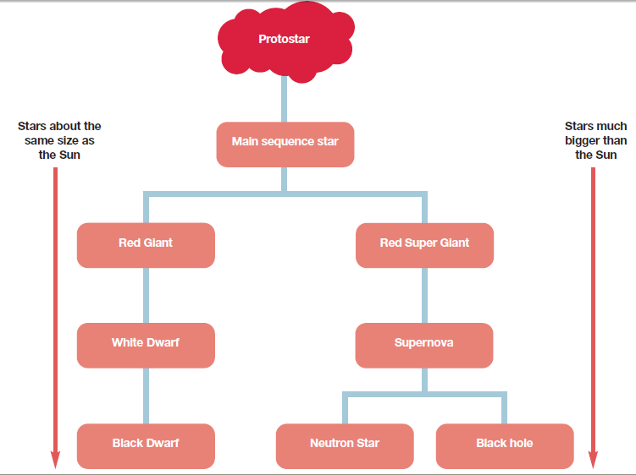

Slide 21
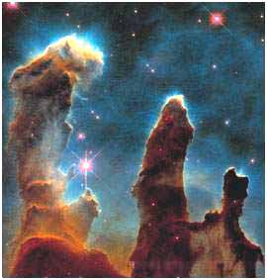
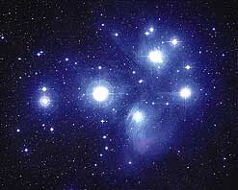
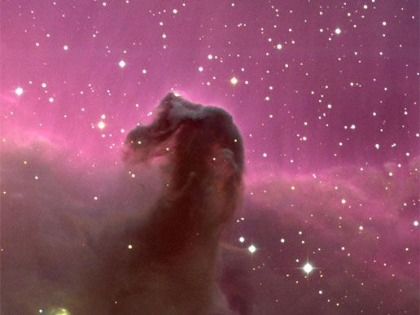
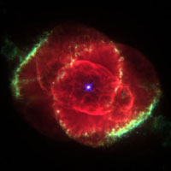
4 types of nebula
Emission
Red, hydrogen in the cloud is excited by stellar radiation
Reflection
Dust in the cloud scatters light from stars so they appear blue
Absorption (or dark)
Dust blocks out light from stars behind
Planetary
The remains of a dying star. Dust and gas ejected into space

Slide 22
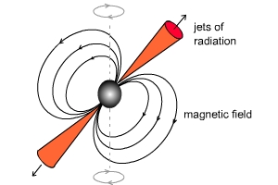
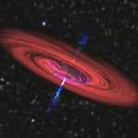
Neutron stars
Very dense spinning objects emitting jets of radiation
Black Holes
Their gravity is so strong that light can’t escape.
Spiralling matter produces x rays we can detect.
They may account for much of the hidden mass in the universe

